Slide 1
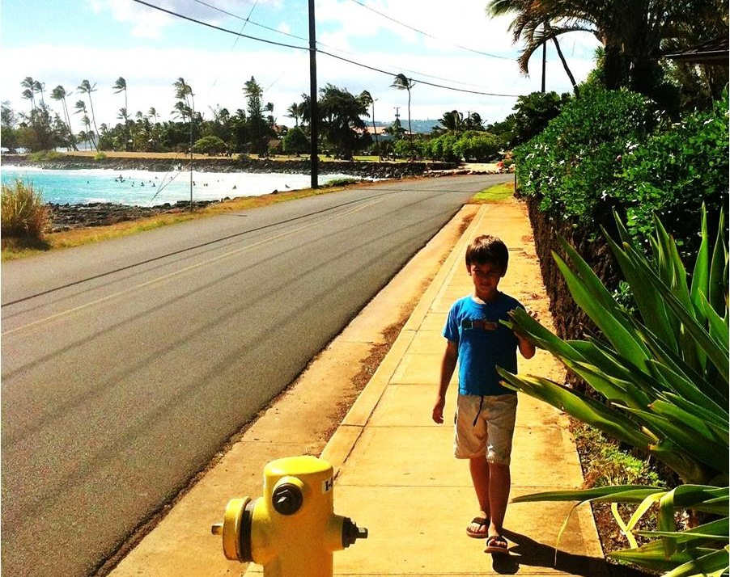
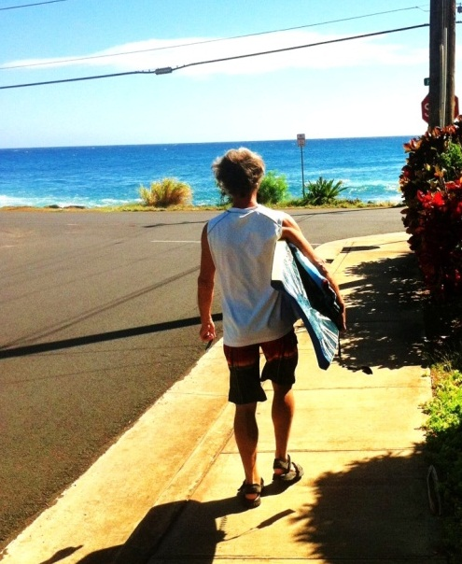
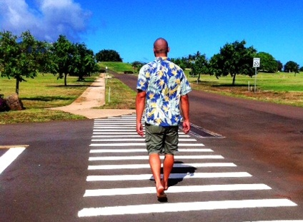
Complete
Streets
Implementation on Kaua’i
HHSP
October 2023
Michael Moule, PE, PTOE
Chief of Engineering
Kaua‘i County
Department of Public Works

Slide 2

Policies, Ordinances, Plans, Standards
2010 – Complete Streets Resolution
2013 – Subdivision Ordinance Changed
  Streets must accommodate multimodal circulation networks
  Sidewalks required in R-4 or greater (previously R-10)
  Short Block lengths; pedestrian ways required
2018 – Kaua‘i Street Design Manual
  New Street Typology
  New Street Sections
  Design parameters (with references)
  Traffic control device guidelines
2018 – General Plan Update
  Ongoing community plans
Minor
Connector
Complete Streets on Kaua’i

Slide 3
Institutionalization
Committed Mayor and Department Heads
Built Environment Task Force
Standard Operation Procedures
Staff
  Training
  Recruitment – big challenge
Leverage Federal Aid Funding
Complete Streets on Kaua’i

Slide 4
Public Outreach
Charrettes for large DPW projects, follow-up meetings/updates
Significant outreach by Planning Department for General Plan and community plan (APA award)
County Council Resolutions
Complete Streets on Kaua’i

Slide 5

Projects
“Lighter, Quicker, Cheaper”
Kilauea Safe Routes to School Action Plan
Restriping after paving projects
  Narrow lanes to add paved shoulders
  Four to three lane “road diets” (forthcoming)
Complete Streets on Kaua‘i

Slide 6
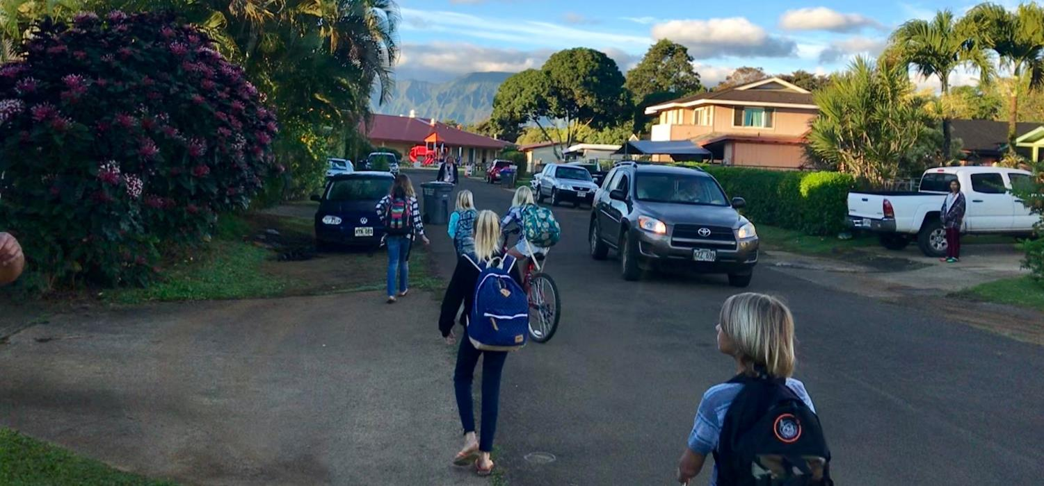
Kamali‘i Street
Before

Slide 7
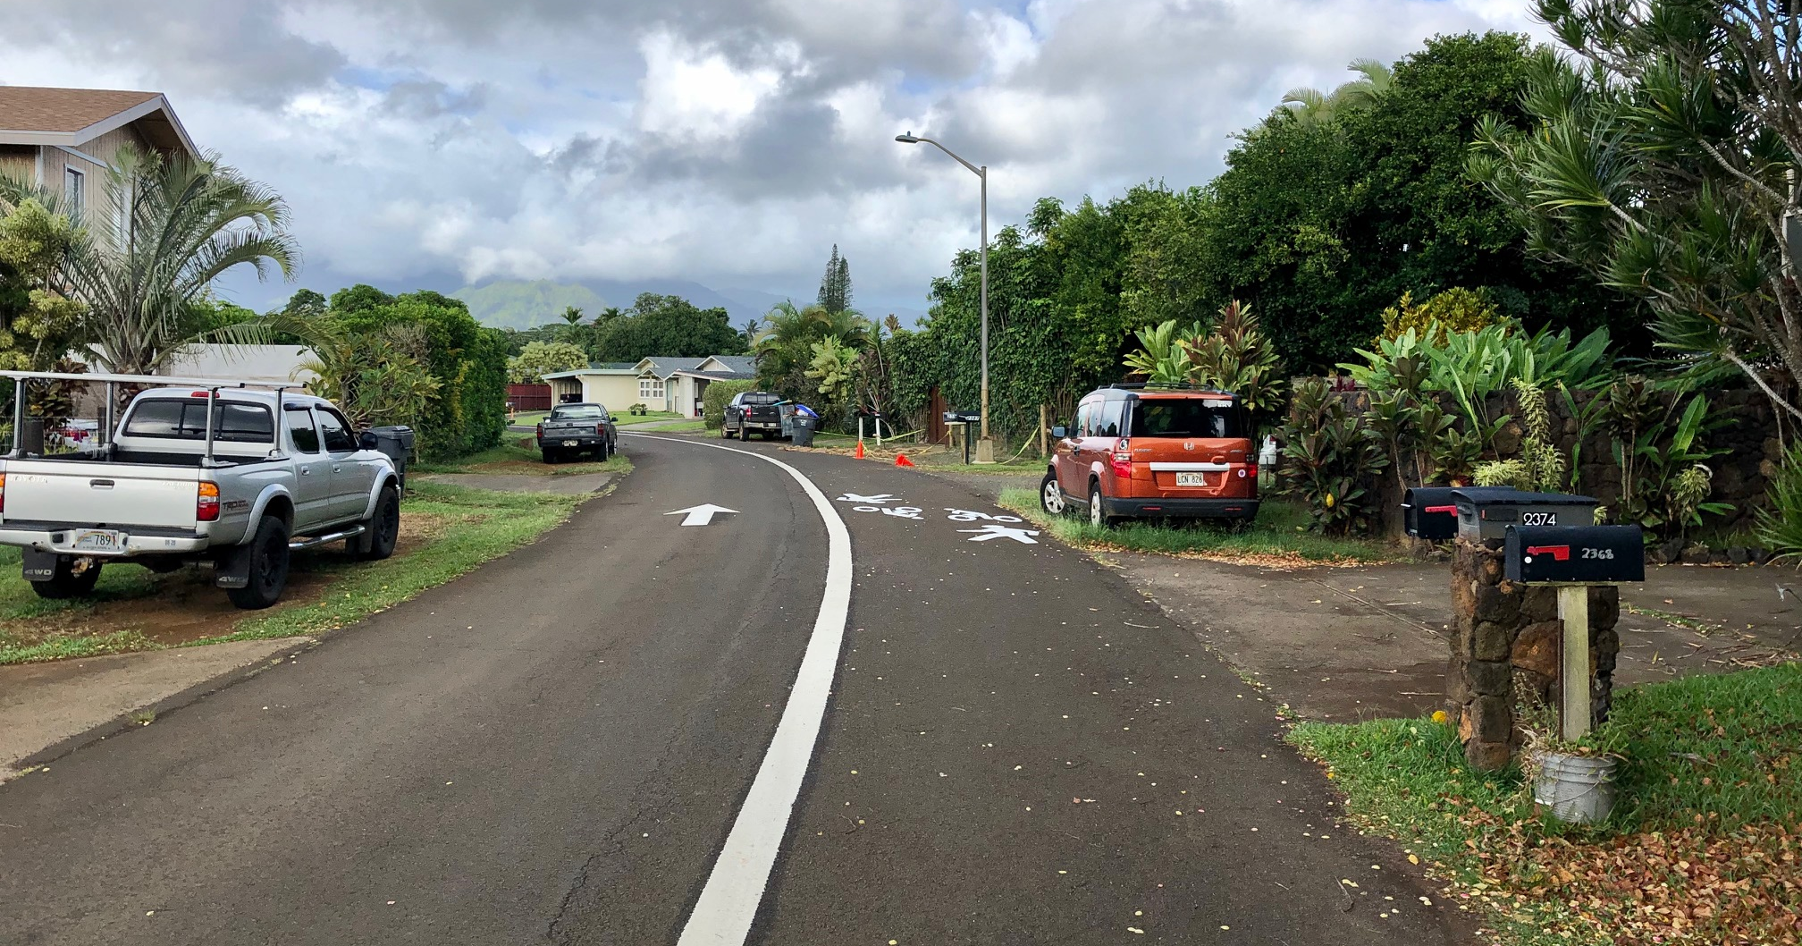
Kamali‘i Street
After – most of the length (one way for cars)

Slide 8
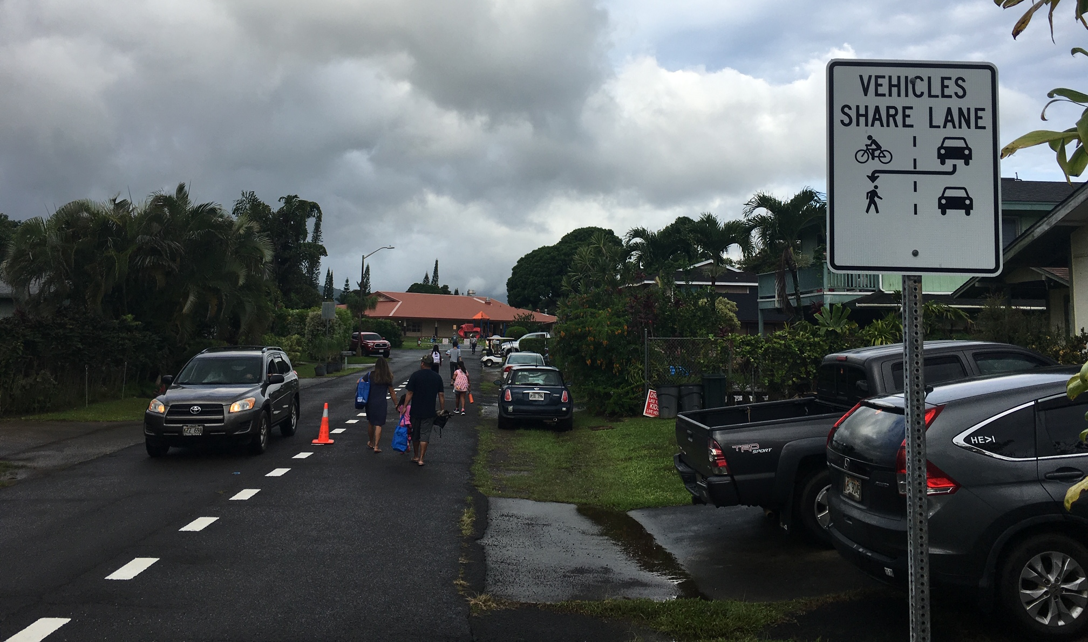
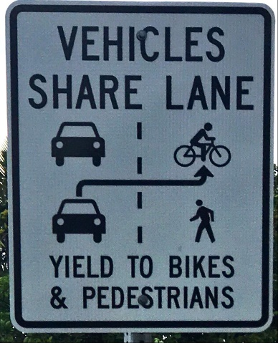
Kamali‘i Street
Block between the school and Kahe Street (“advisory lane”)

Slide 9
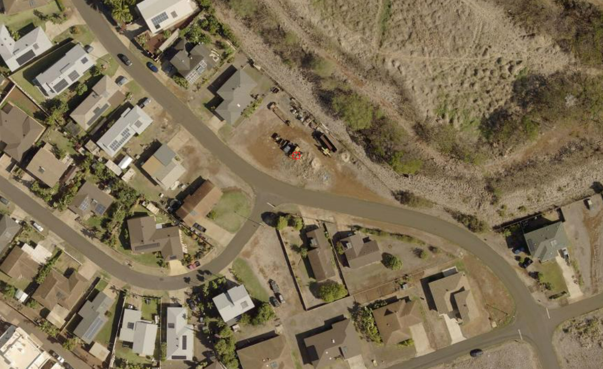
Add Shoulder after Repaving - Before
Complete Streets on Kaua’i

Slide 10
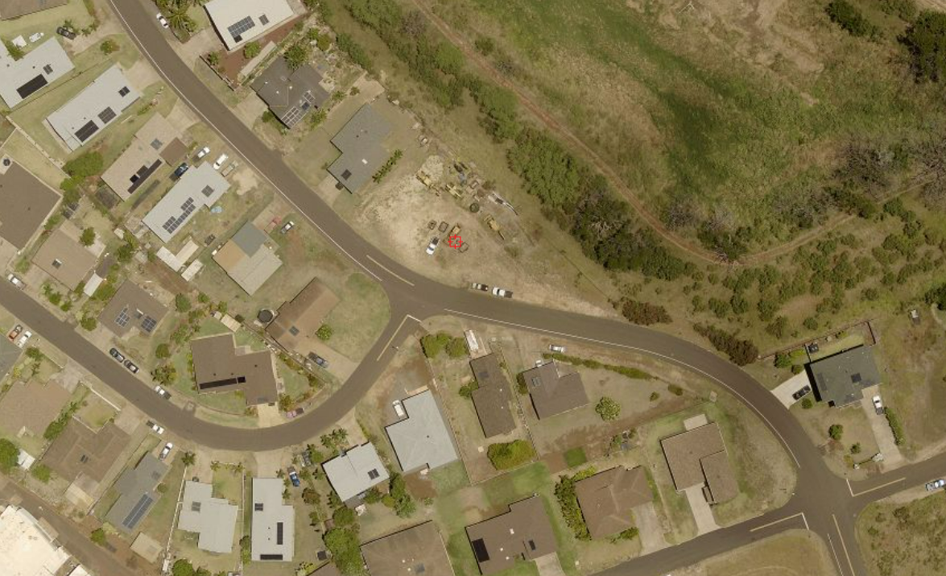
Add Shoulder after Repaving - After
Complete Streets on Kaua’i

Slide 11
Shopping Center Area in Līhu‘e
4-lane to 3-lane road diets
  Nuhou Street
  Kaneka Street
  Kalepa Street
  Pikake Street
Built as “major streets” under old standards; marked as 4-lane undivided.
Traffic volumes max out at 8,000 vehicles per day – opportunity for restriping
Federal Aid Projects on Kaua‘i

Slide 12
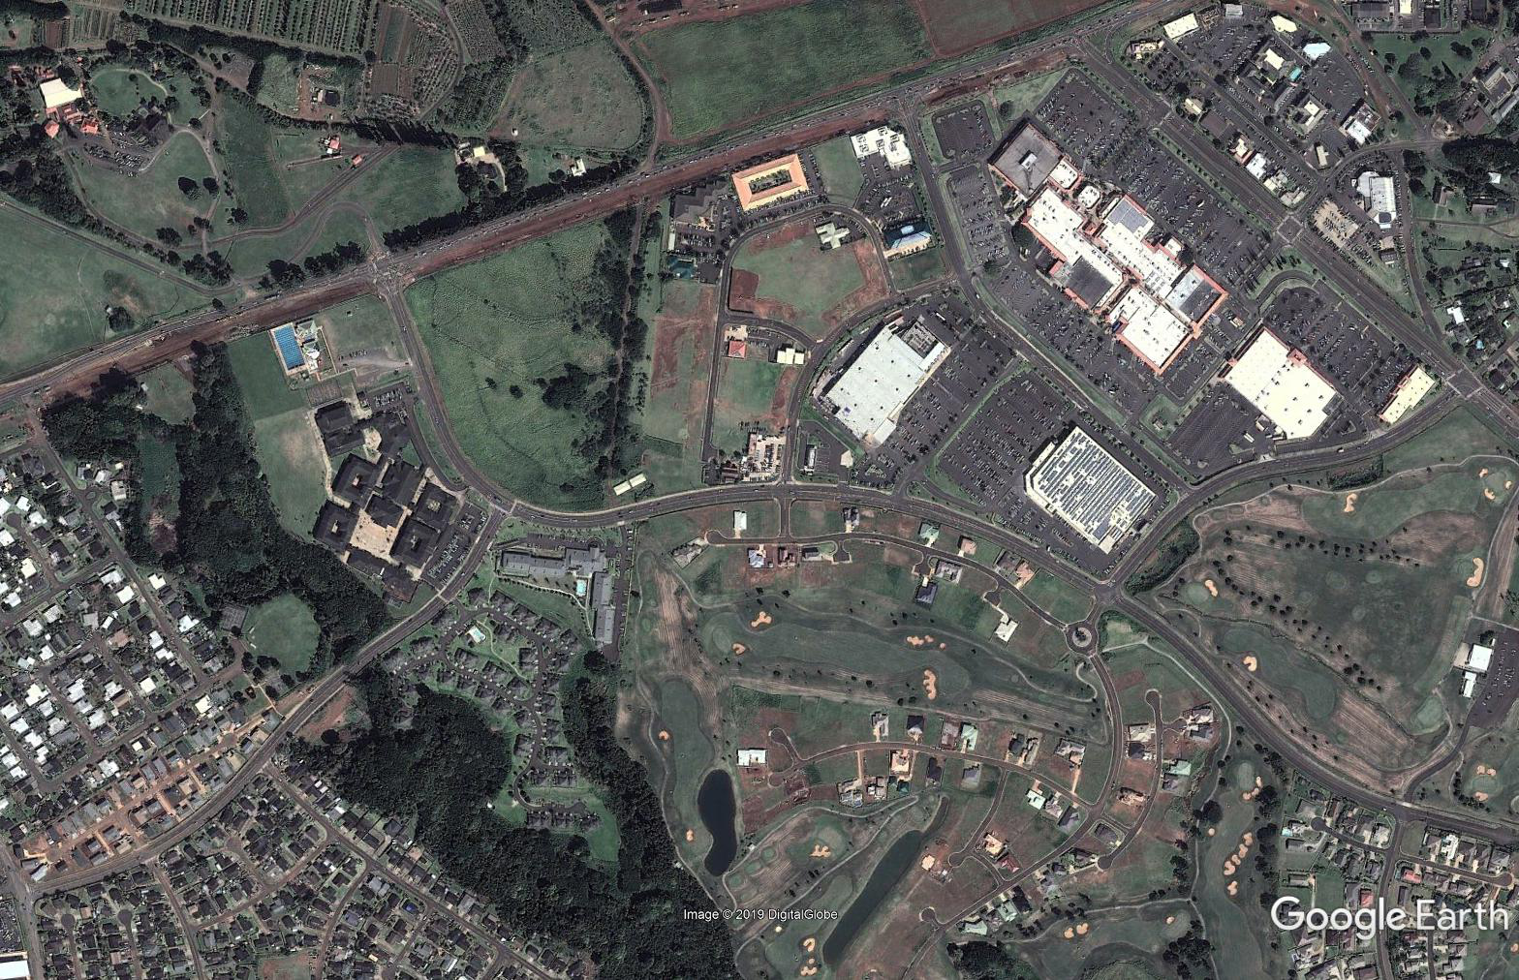
Kaumuali‘i Highway (HDOT)
Nāwiliwili Road (HDOT
Kalepa Street
Nuhou Street
Pikake Street
Kaneka Street
Federal Aid Projects on Kaua‘i

Slide 13
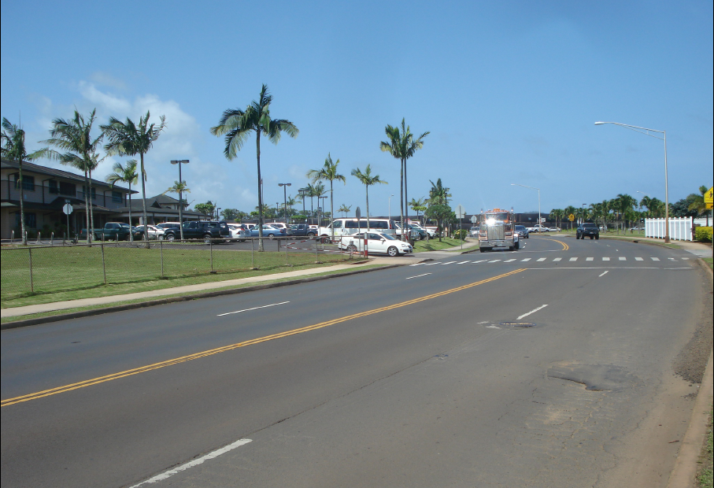
Federal Aid Projects on Kaua‘i

Slide 14
Federal Aid Projects on Kaua‘i

Slide 15
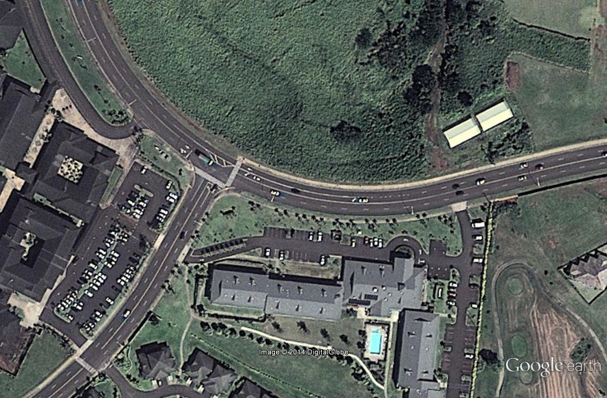
Nuhou Street
Kaneka Street
Federal Aid Projects on Kaua‘i

Slide 16
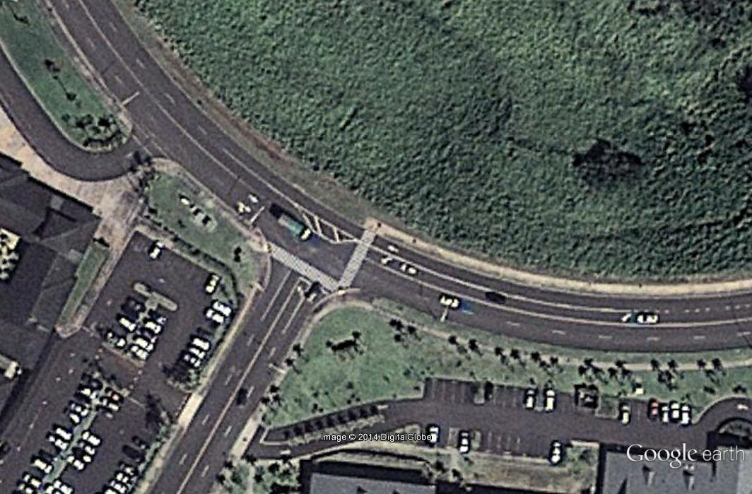
Nuhou Street
Kaneka Street
Federal Aid Projects on Kaua‘i

Slide 17
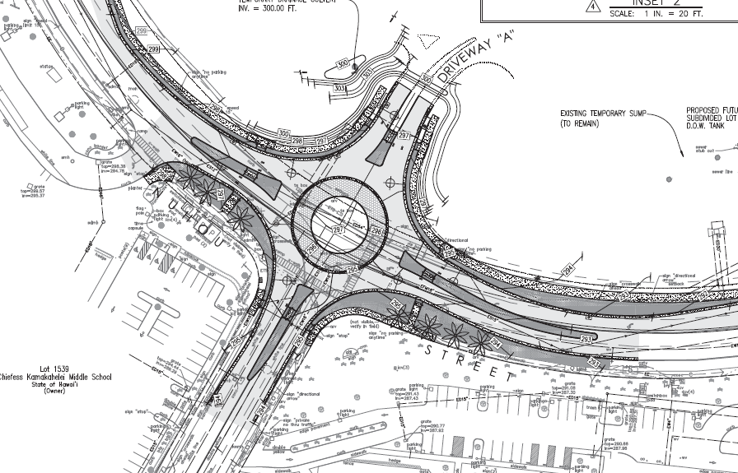
Federal Aid Projects on Kaua‘i

Slide 18
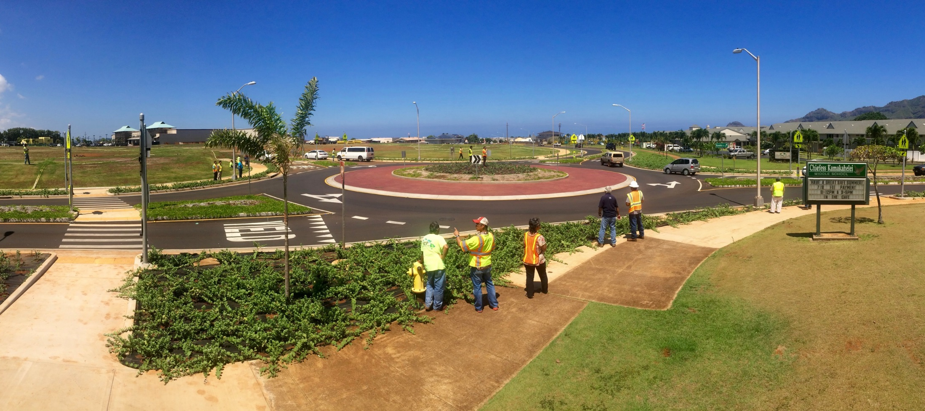
Federal Aid Projects on Kaua‘i

Slide 19
Pikake Stret
Nuhou Street
Federal Aid Projects on Kaua‘i

Slide 20
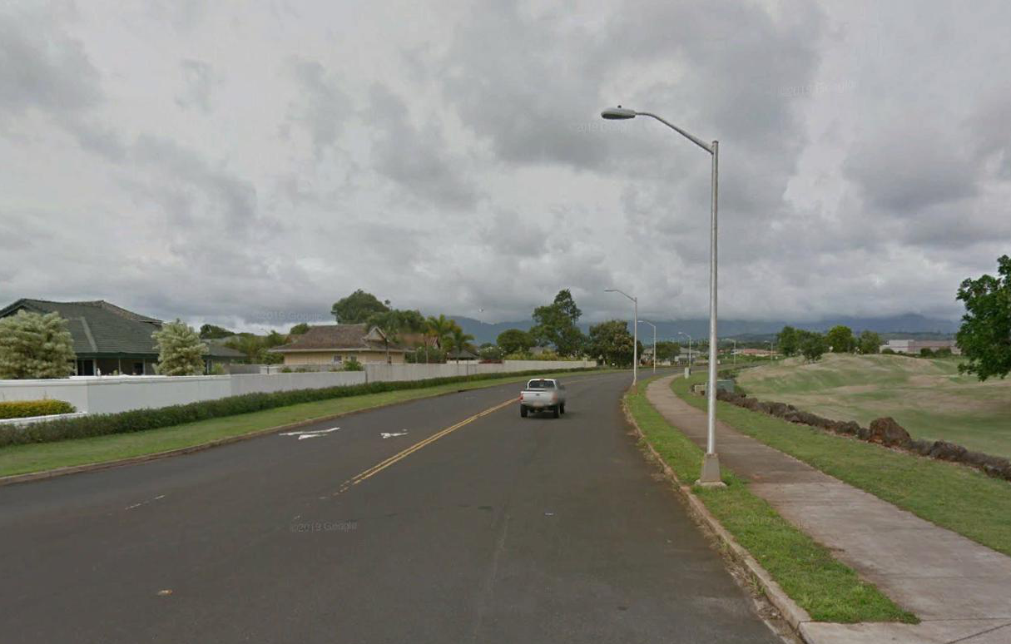
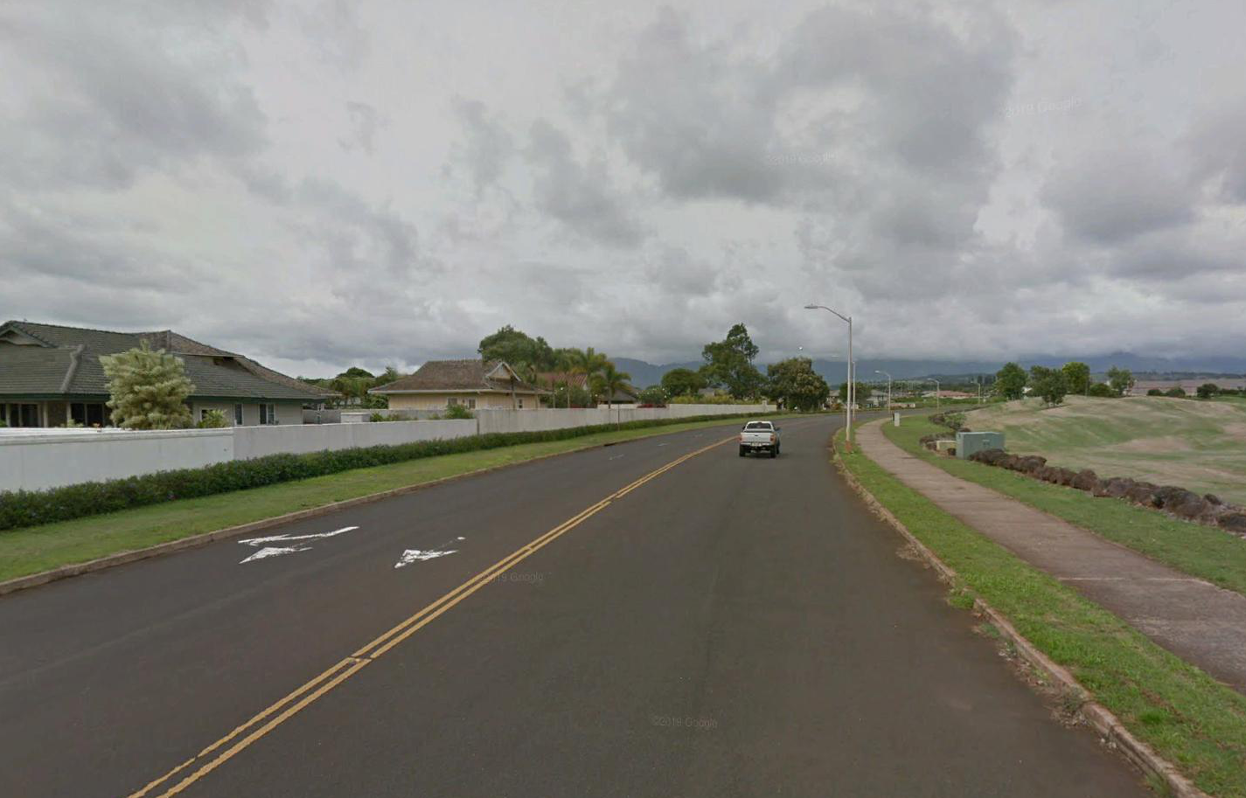
Federal Aid Projects on Kaua‘i

Slide 21
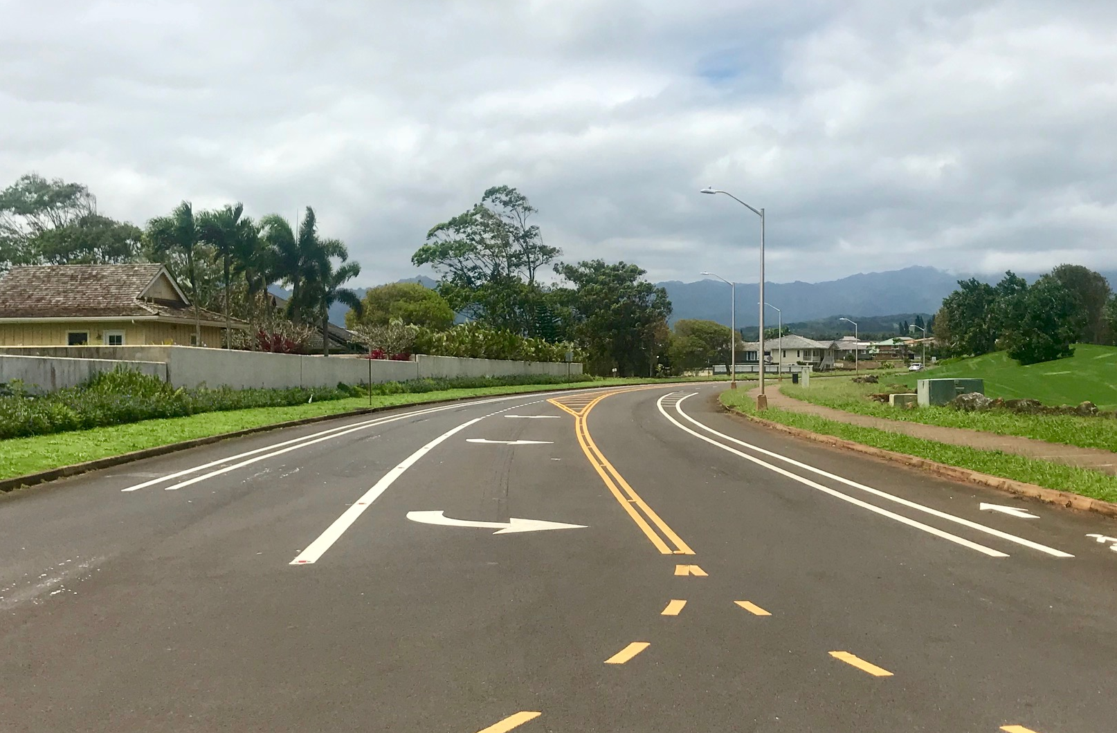
Federal Aid Projects on Kaua‘i

Slide 22
Kalepa Street
Pikake Street
Federal Aid Projects on Kaua‘i

Slide 23
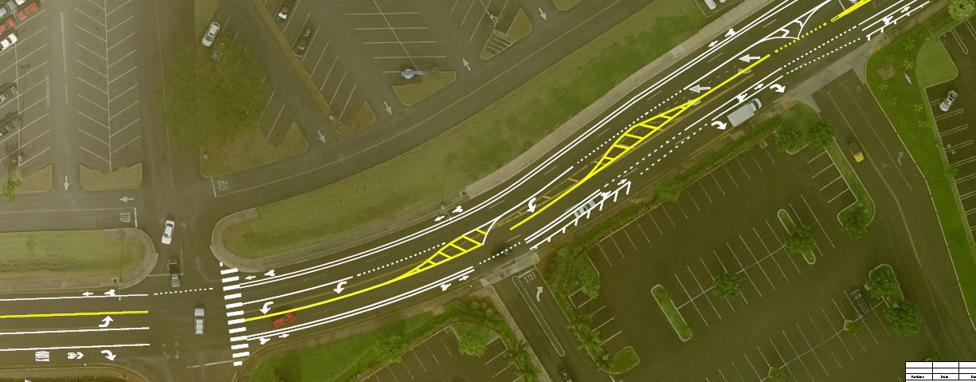
Federal Aid Projects on Kaua‘i

Slide 24
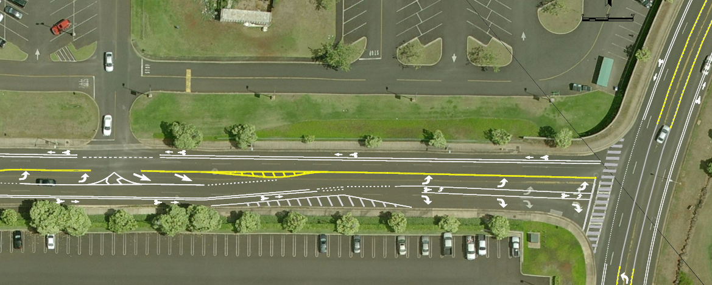
Federal Aid Projects on Kaua‘i

Slide 25
Projects
Road Retrofits/Reconstruction (Federal Funds)
Hardy Street
  Eiwa Street
Puhi Road
Maluhia Road / Koloa Road
Lihue Town Core Mobility and Revitalization
Complete Streets on Kaua’i

Slide 26
Hardy Street
$8M Complete Streets project (Federal Aid)
Serves businesses, residences, elementary school, convention hall, civic center
New bike lanes; improved sidewalks and crossings; roundabout
Didn’t fully resurface (lesson learned)
Complete Streets on Kaua’i

Slide 27
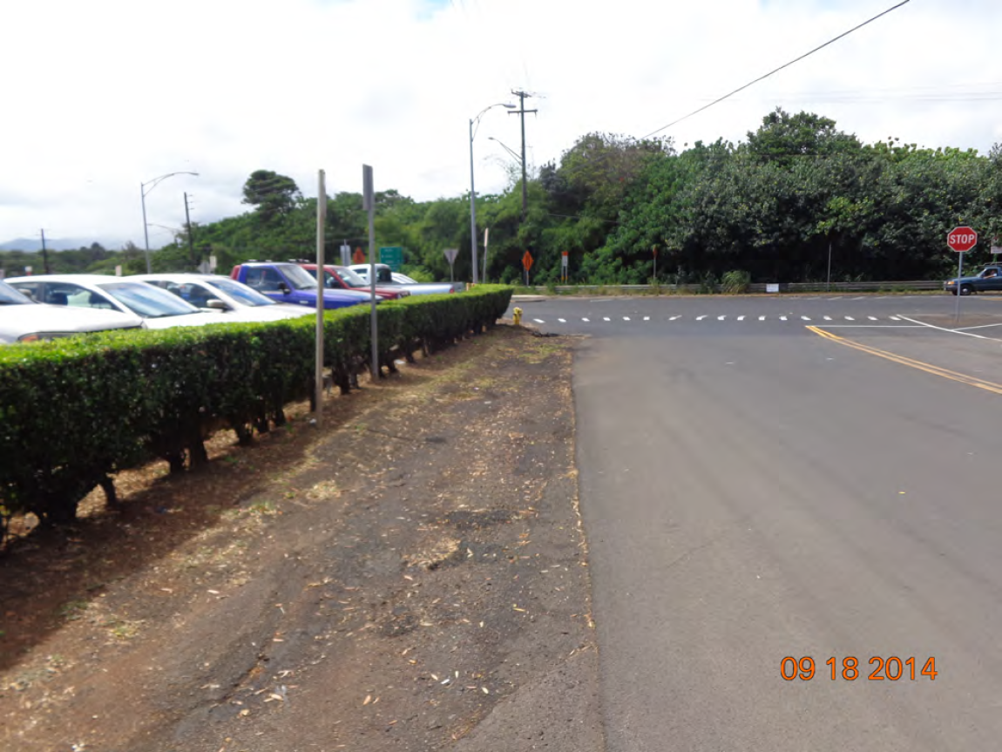
Complete Streets on Kaua’i

Slide 31
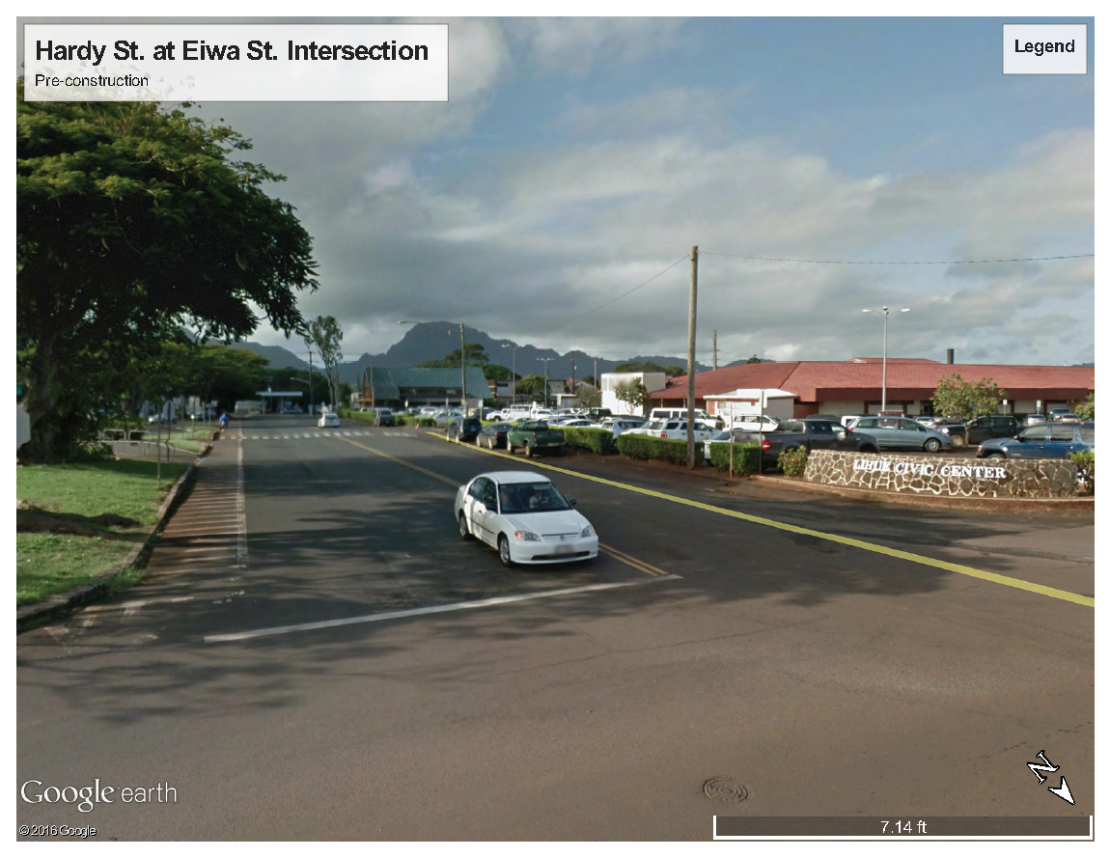

Slide 35
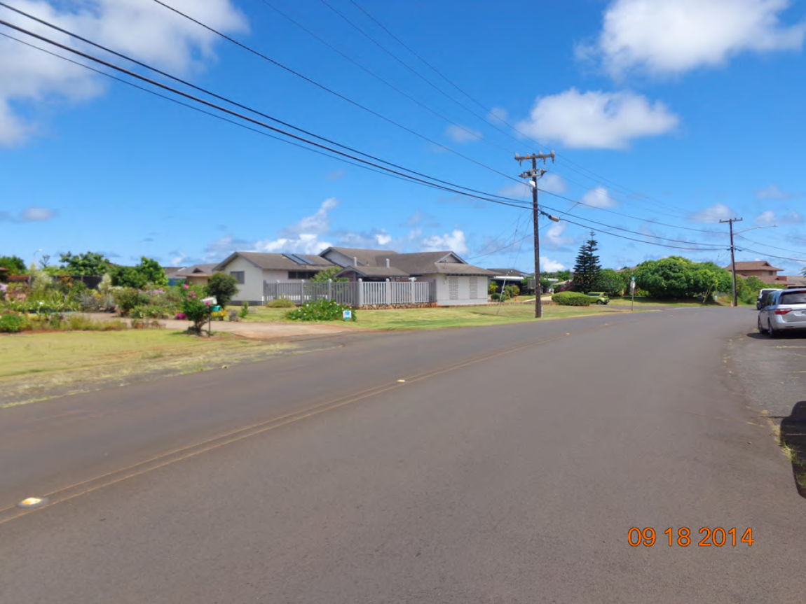

Slide 37
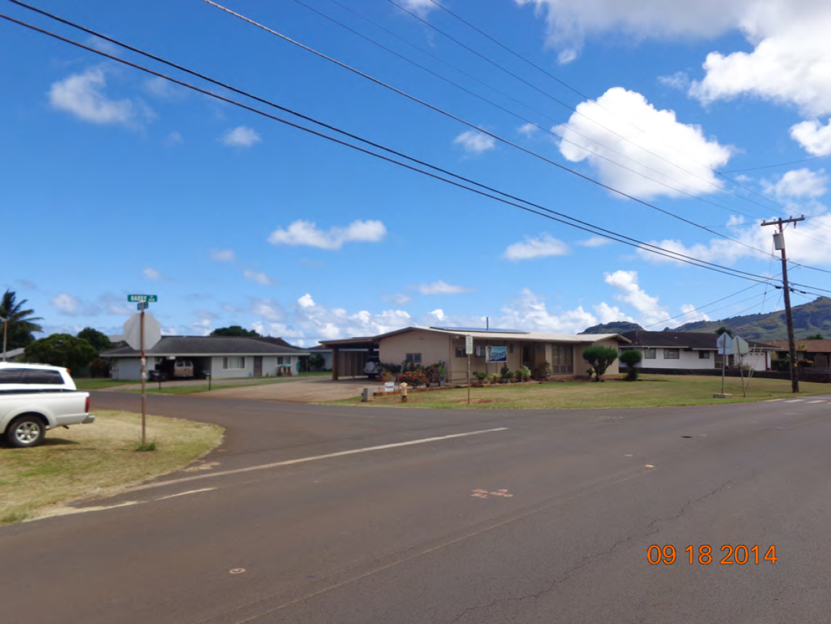

Slide 39
Puhi Road
Federal Aid pavement reconstruction project
Connects schools to residences
Heavy truck traffic, two existing 12’ lanes
Initial design didn’t incorporate Complete Streets
Redesigned during final design process
Complete Streets on Kaua’i

Slide 40
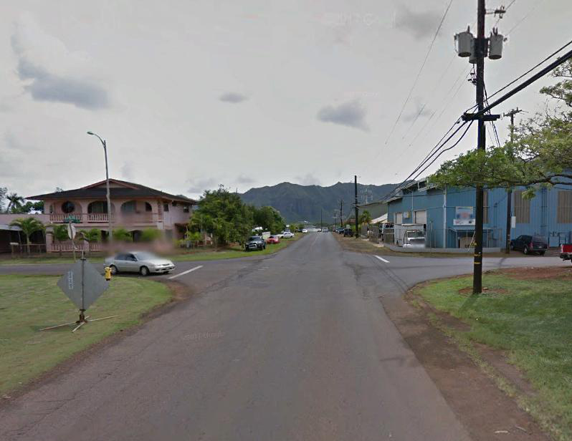
Complete Streets on Kaua’i

Slide 41
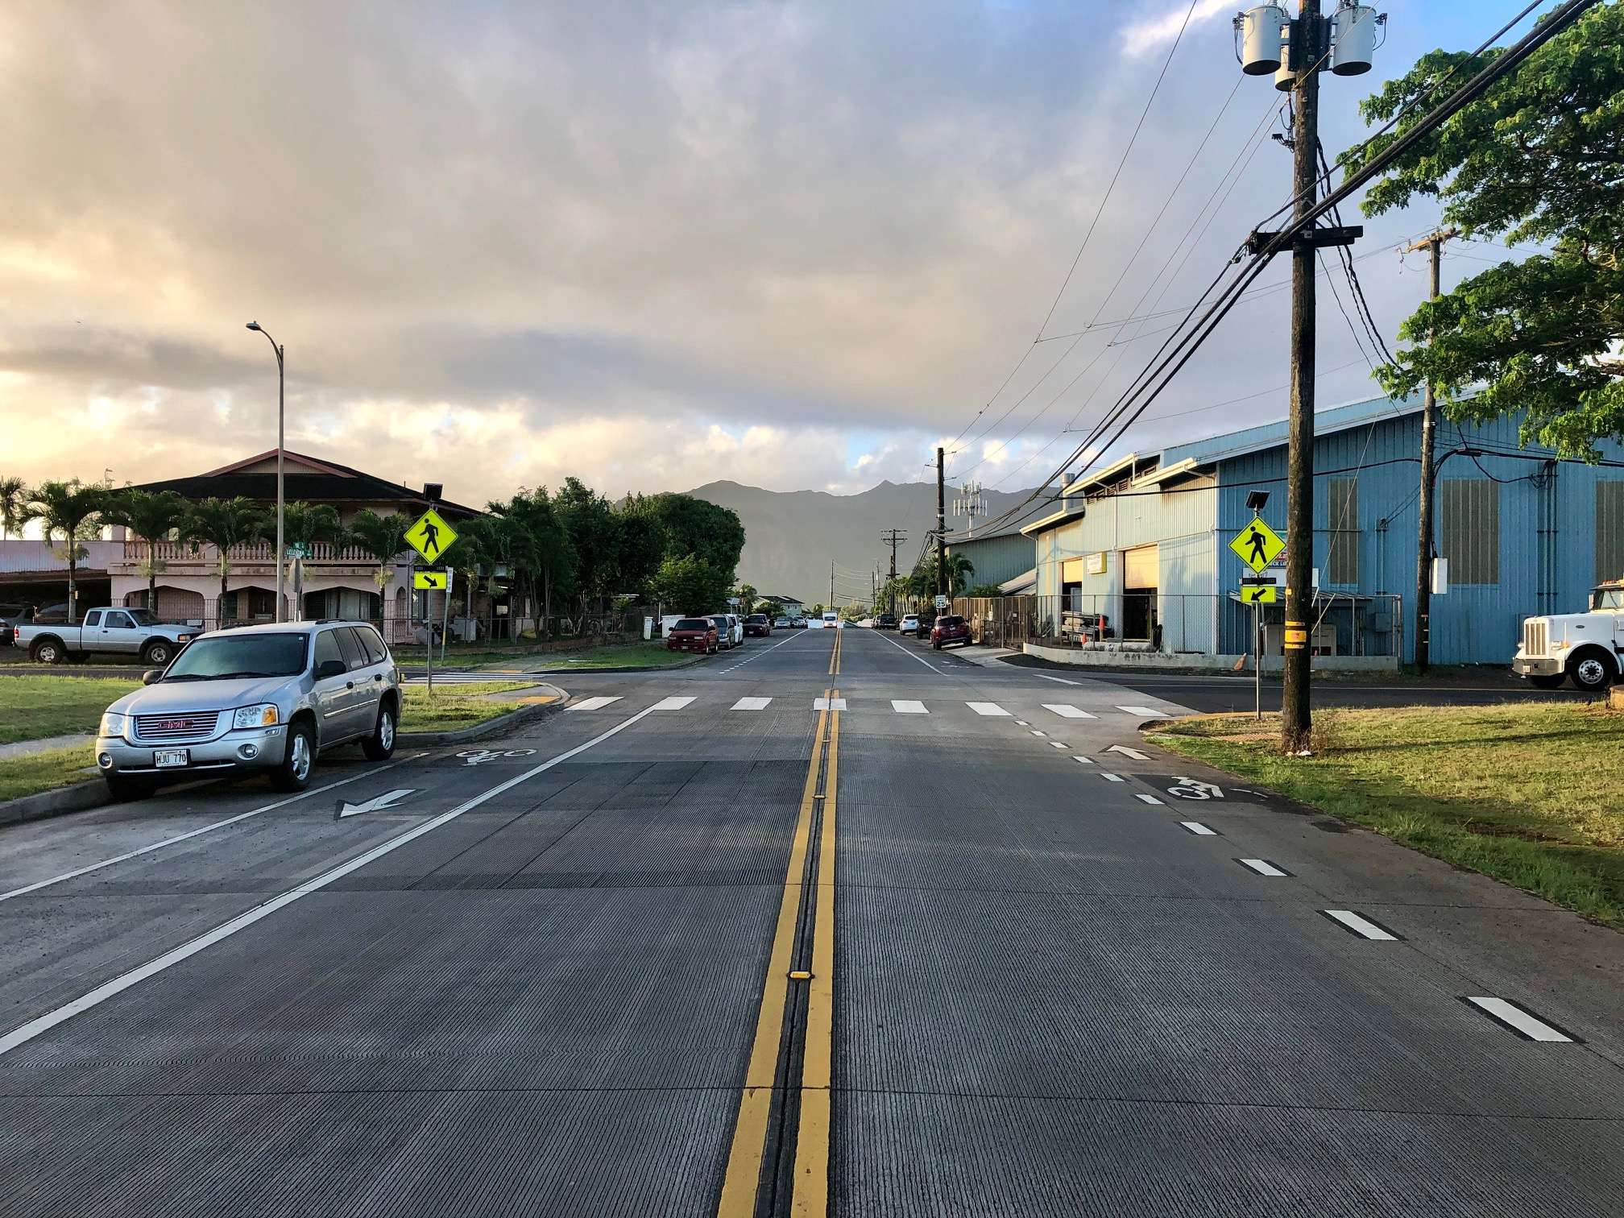
Complete Streets on Kaua’i

Slide 42
Maluhia Road / Koloa Road
Federal Aid pavement project ($20M)
Improvements:
  Paved Shoulders (complete street in rural context)
  Roundabout
  Turn Lanes
Complete Streets on Kaua’i

Slide 43
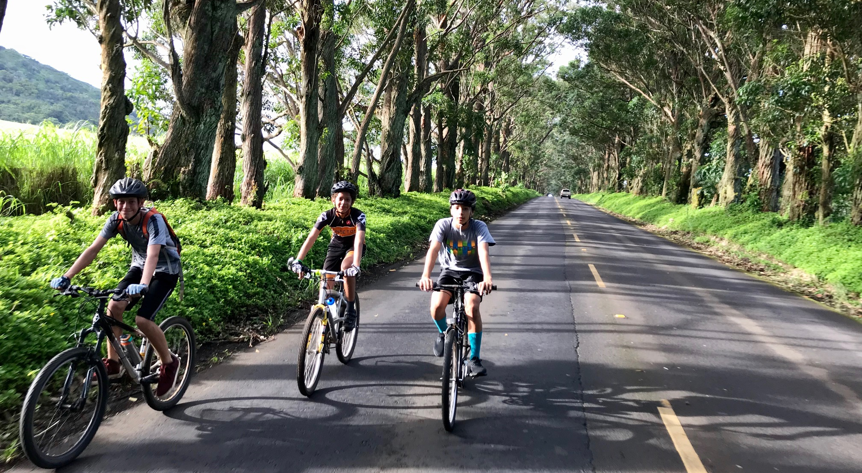
Maluhia Road
(Our famous “Tree Tunnel”)
Complete Streets on Kaua’i

Slide 44
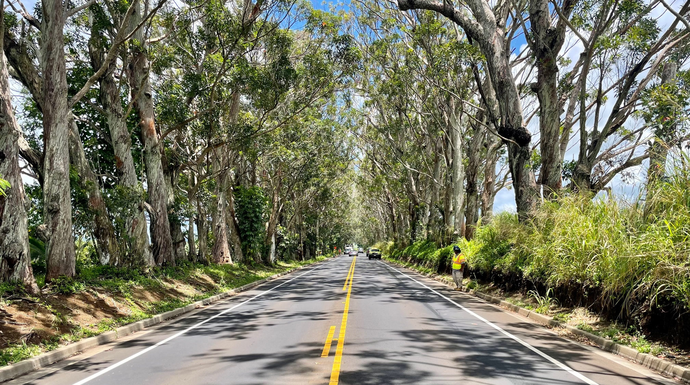
Maluhia Road
(Our famous “Tree Tunnel”)
Complete Streets on Kaua’i

Slide 45
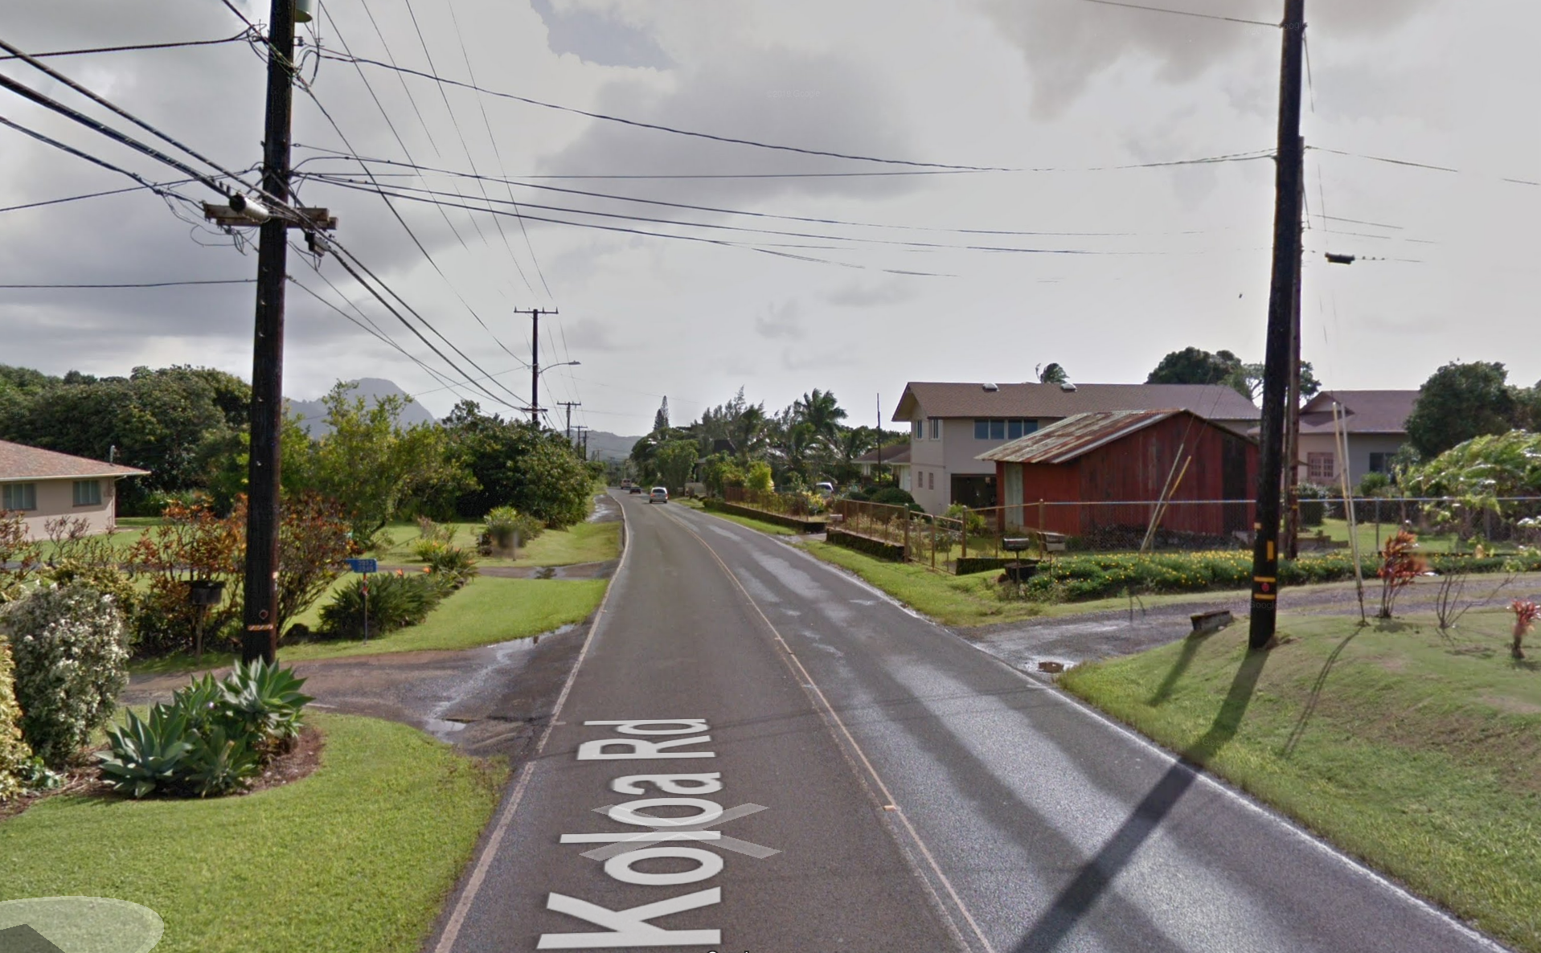
Kōloa Road
Complete Streets on Kaua’i

Slide 46
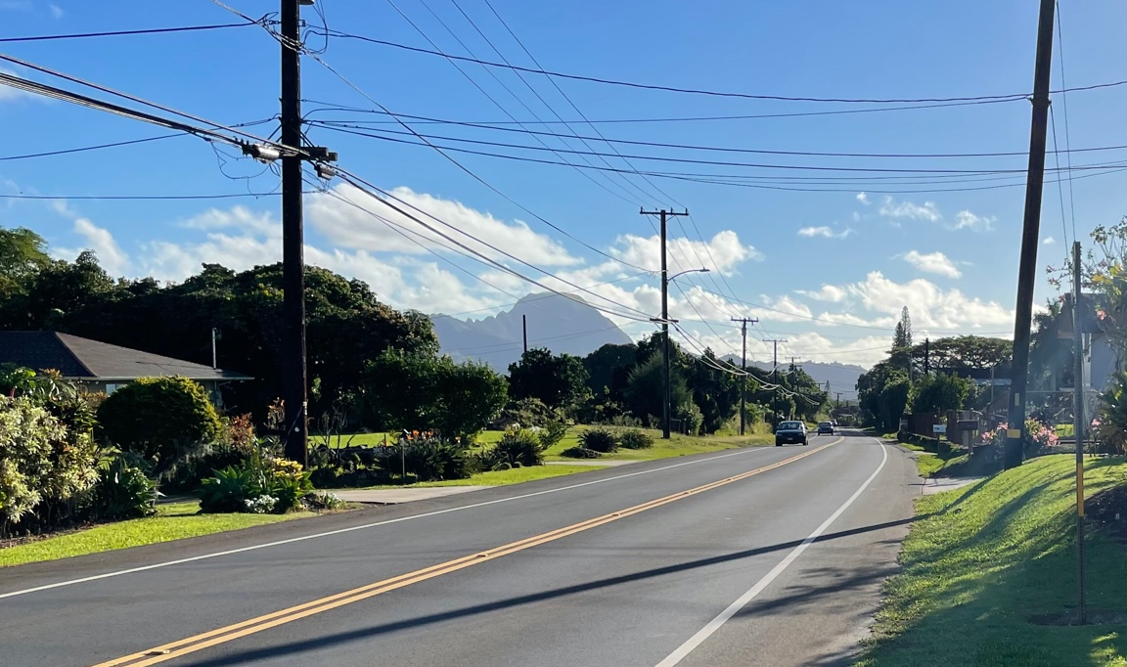
Kōloa Road
Complete Streets on Kaua’i

Slide 47
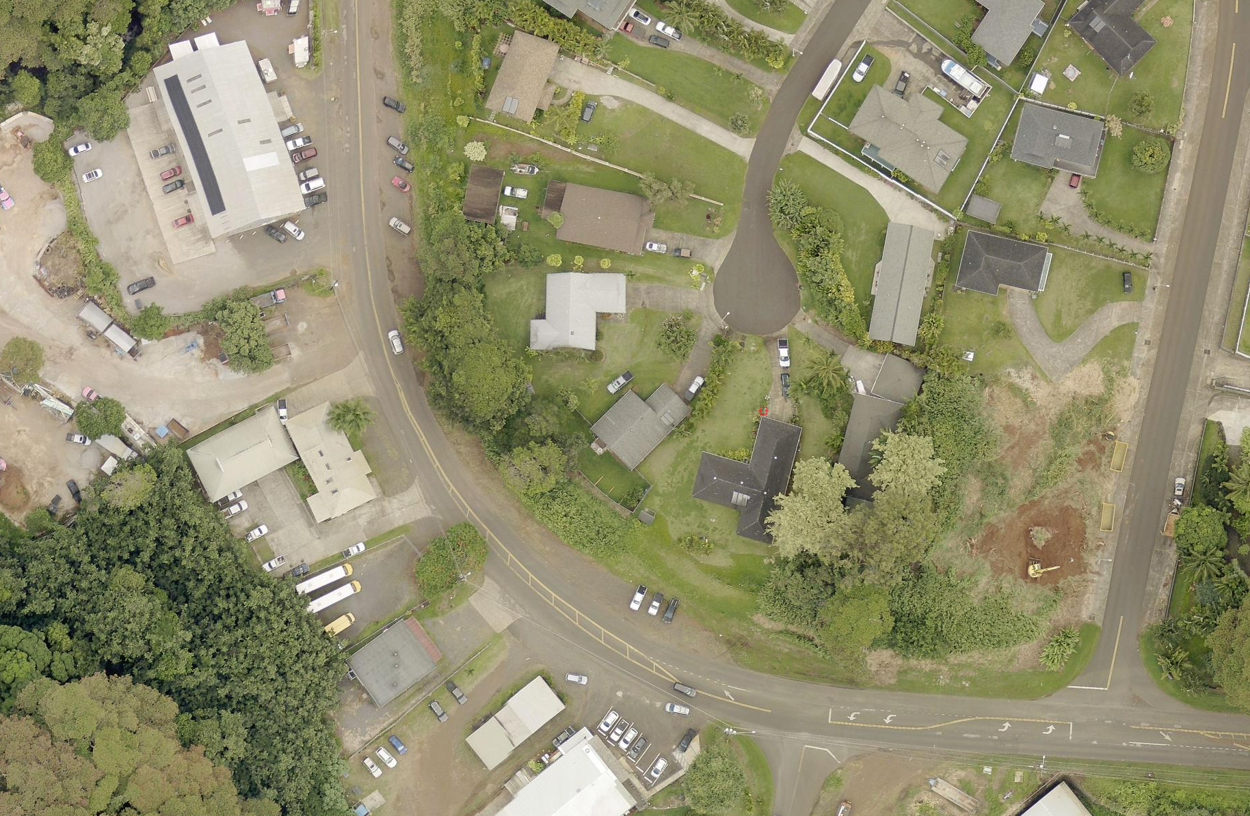
Kōloa Road
Complete Streets on Kaua’i

Slide 48
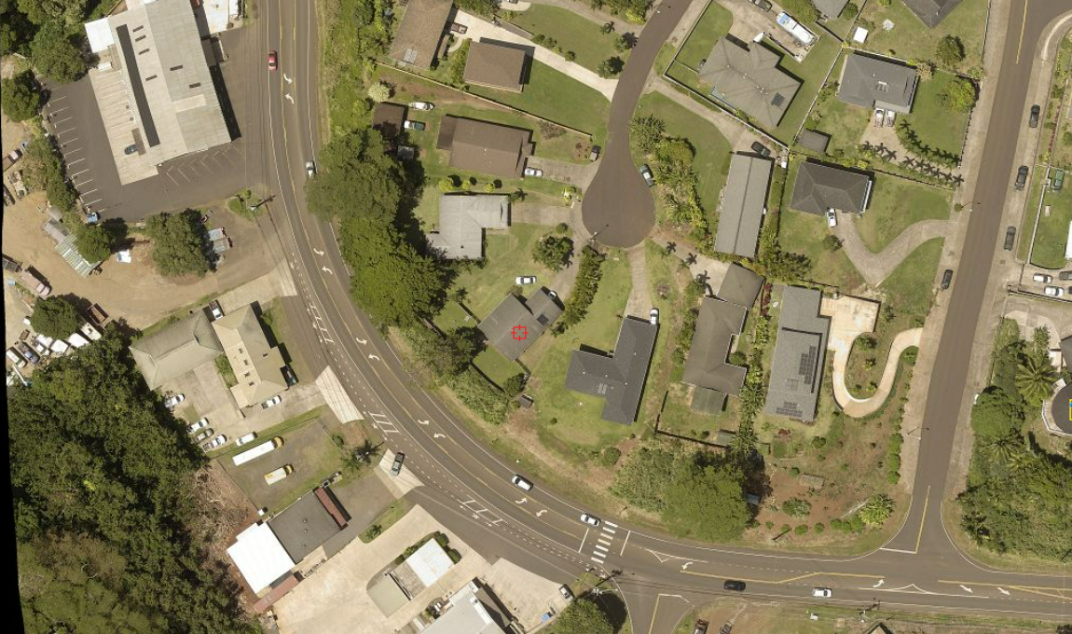
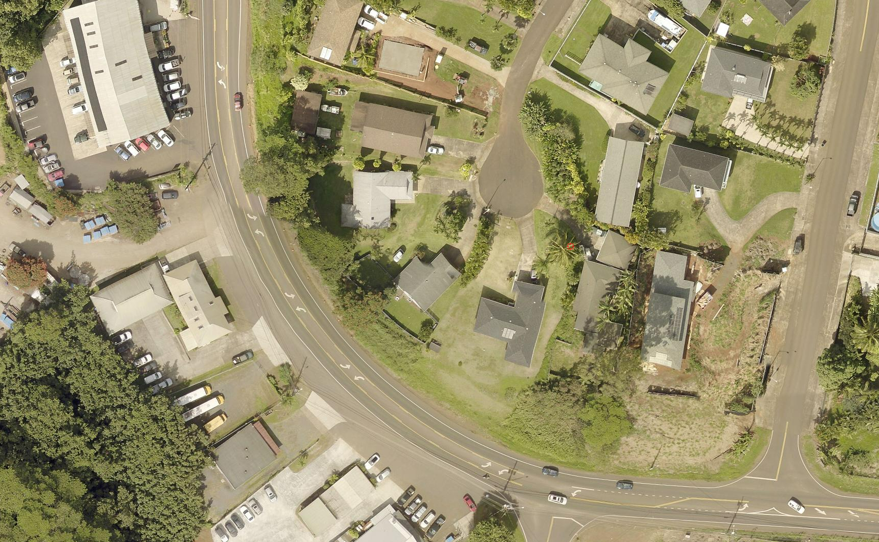
Kōloa Road
Complete Streets on Kaua’i

Slide 49
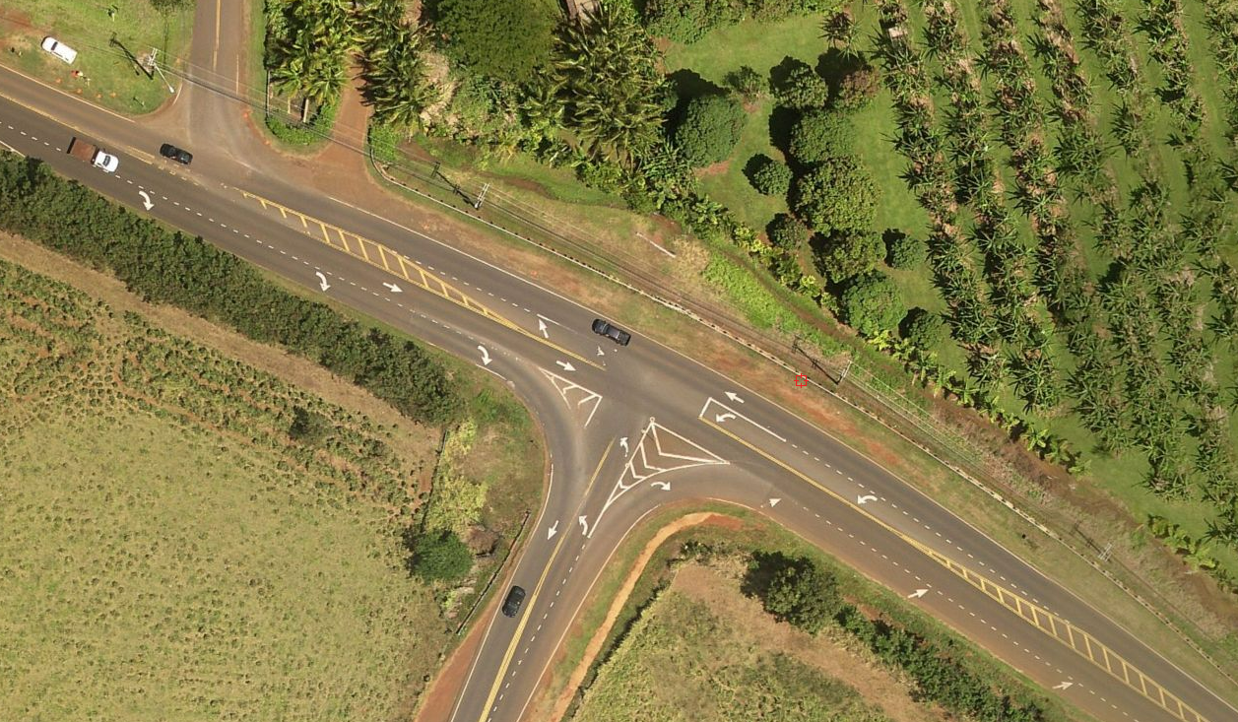
Kōloa Road at Ala Kalanikaumaka
Complete Streets on Kaua’i

Slide 50
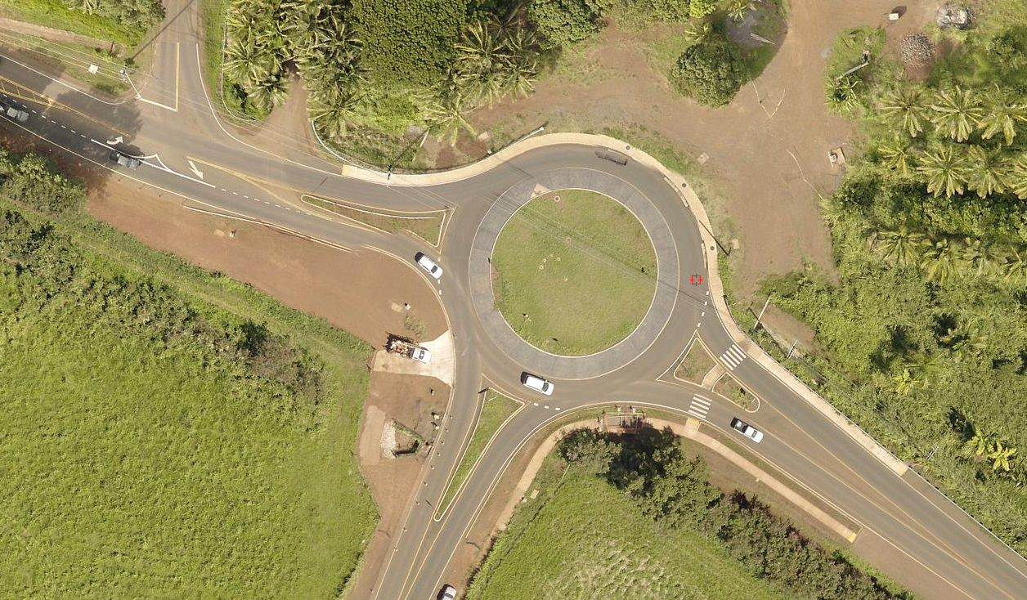
Kōloa Road at Ala Kalanikaumaka
Complete Streets on Kaua’i

Slide 51
Lihue Town Core Mobility and Revitalization
$17M project, funded with $15M TIGER Grant
Land use plan approved first
Main focus was Rice Street (Kauai’s main street) road diet (4-lane to 3-lane conversation
6 other components nearby
Complete Streets on Kaua’i

Slide 52
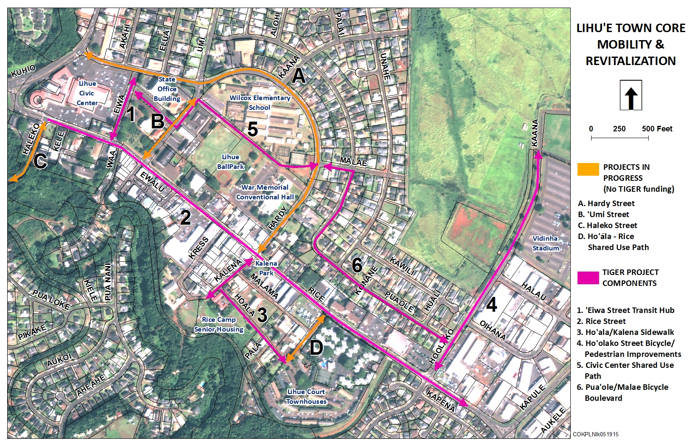
Līhu‘e Town Core Project (TIGER Grant)
Federal Aid Projects on Kaua‘i

Slide 53
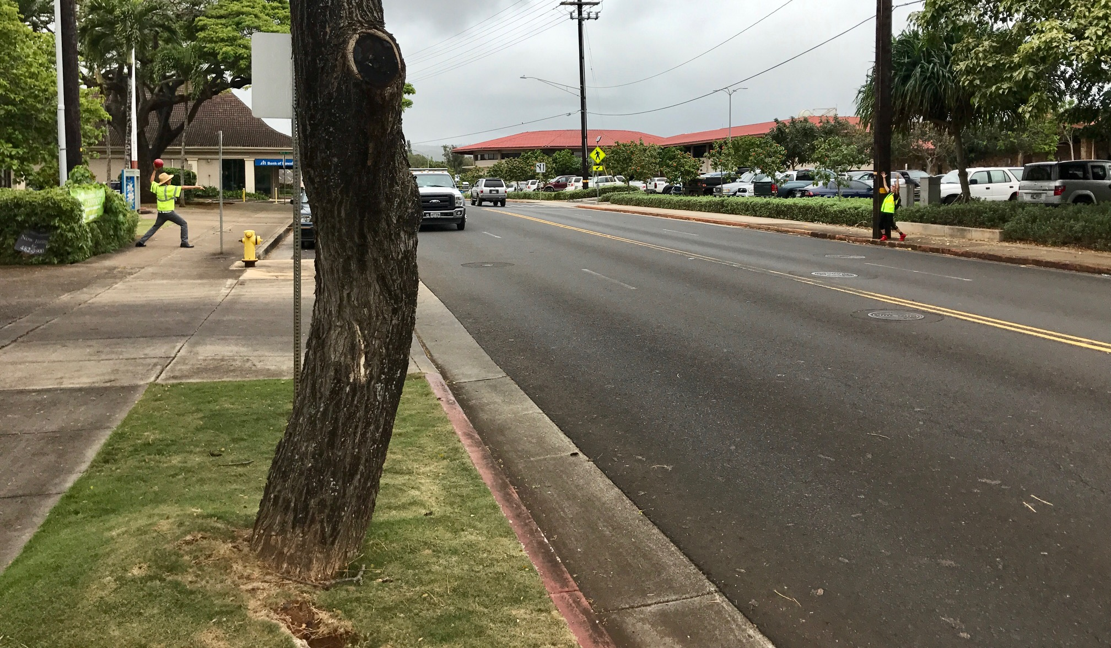
Līhu‘e Town Core Mobility and Revitalization
Complete Streets on Kaua’i

Slide 54
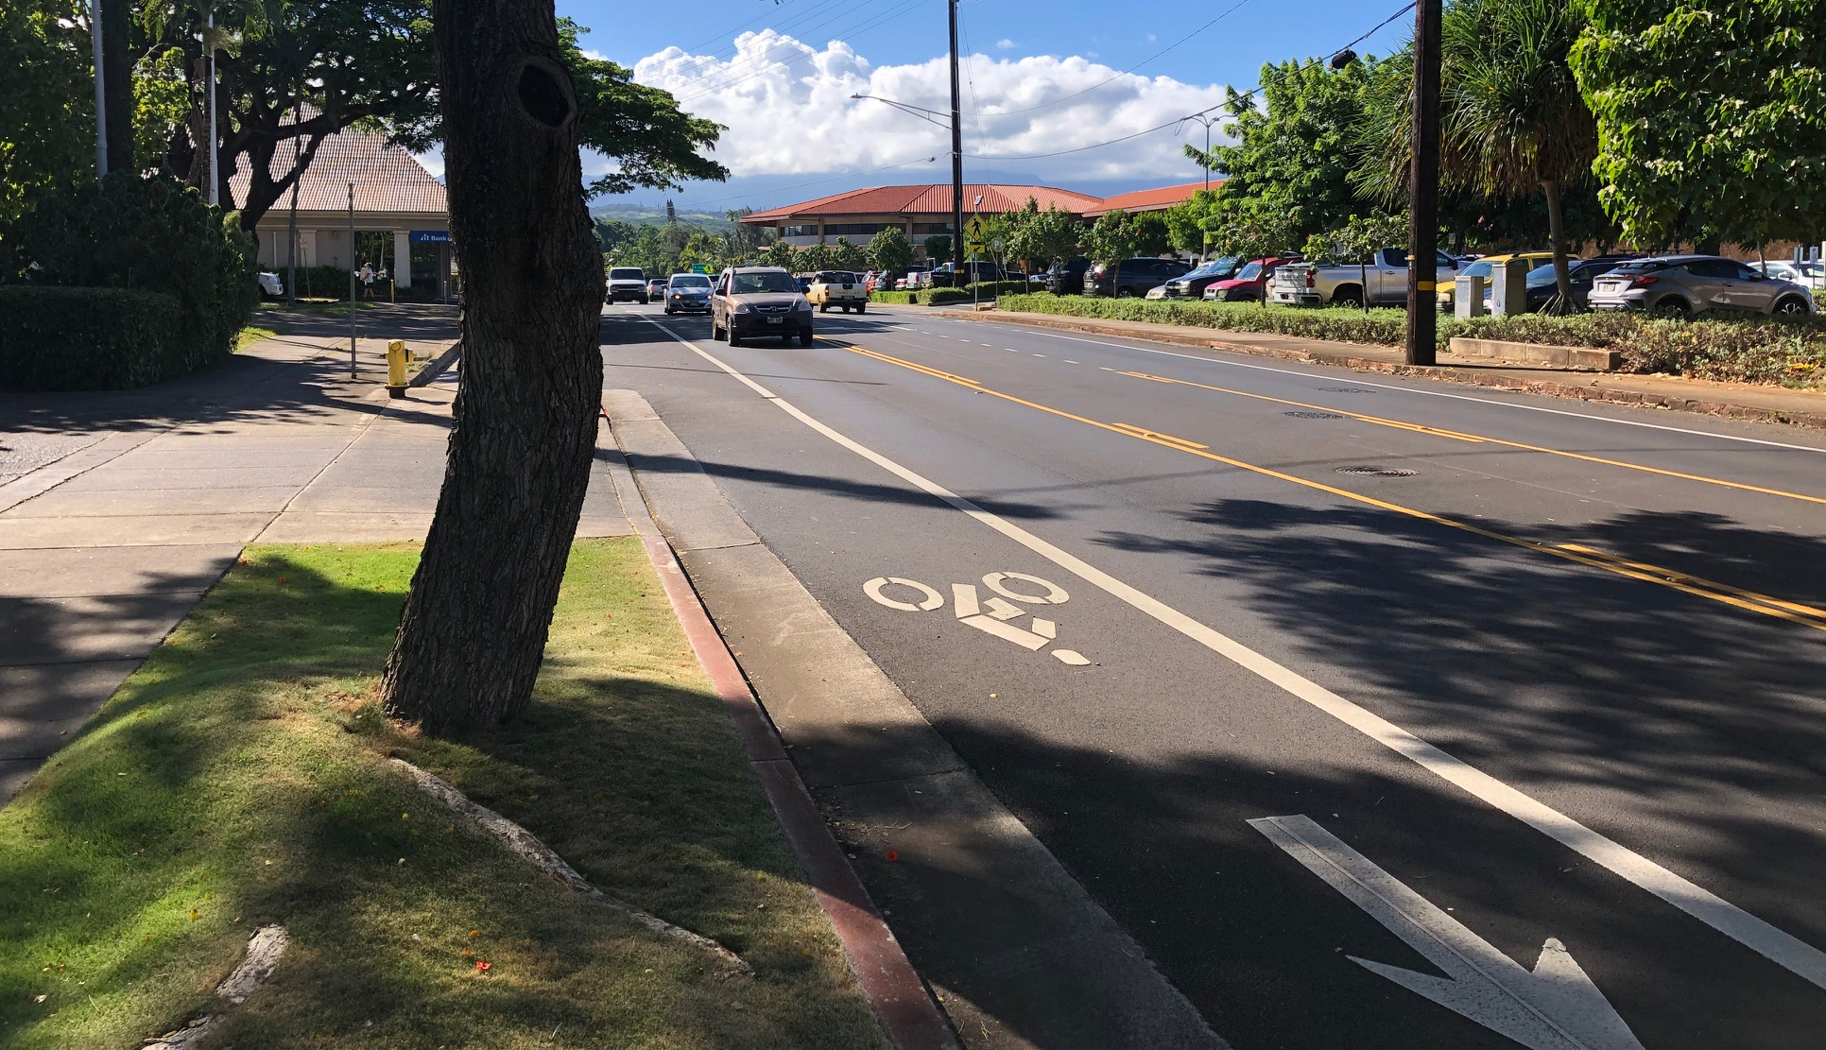
Līhu‘e Town Core Mobility and Revitalization
Complete Streets on Kaua’i

Slide 55
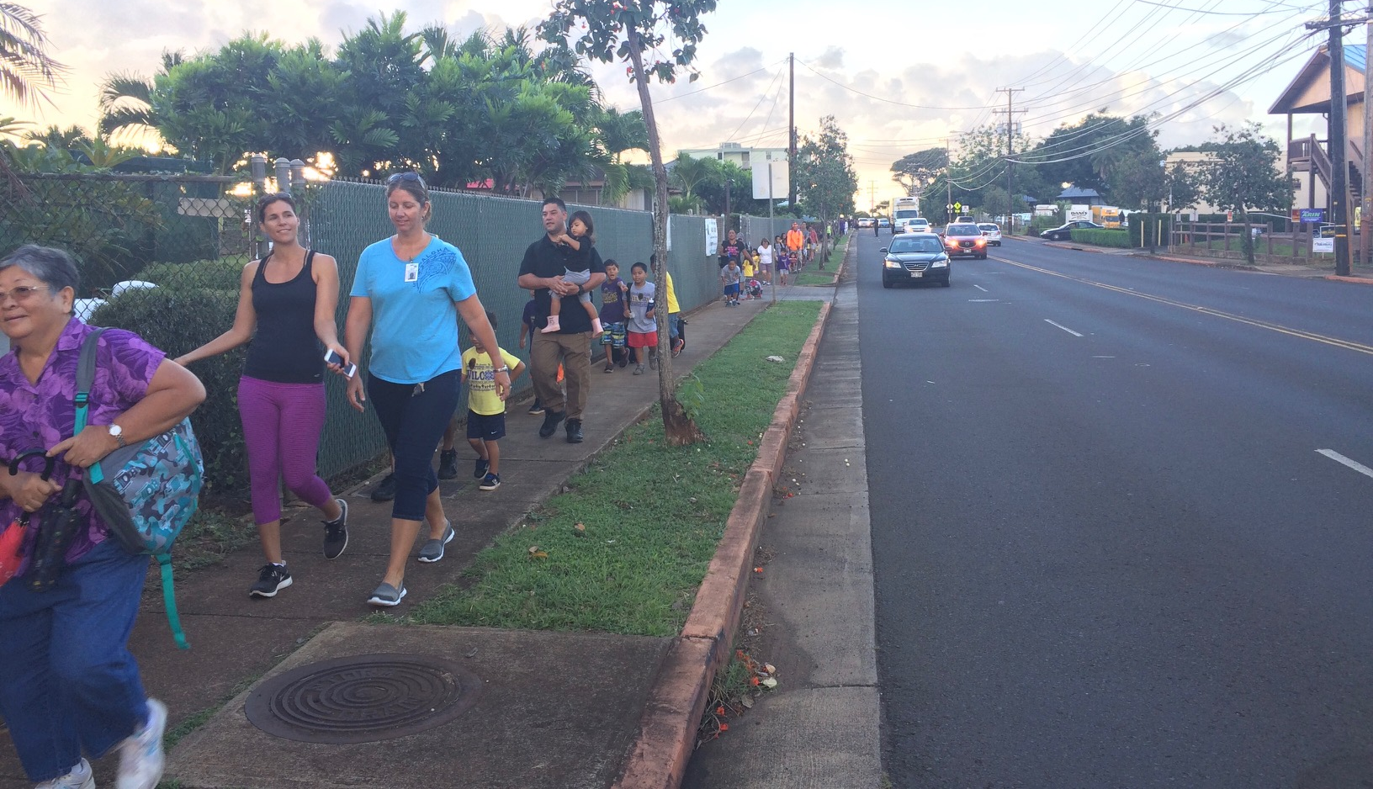
Līhu‘e Town Core Mobility and Revitalization
Complete Streets on Kaua’i

Slide 56
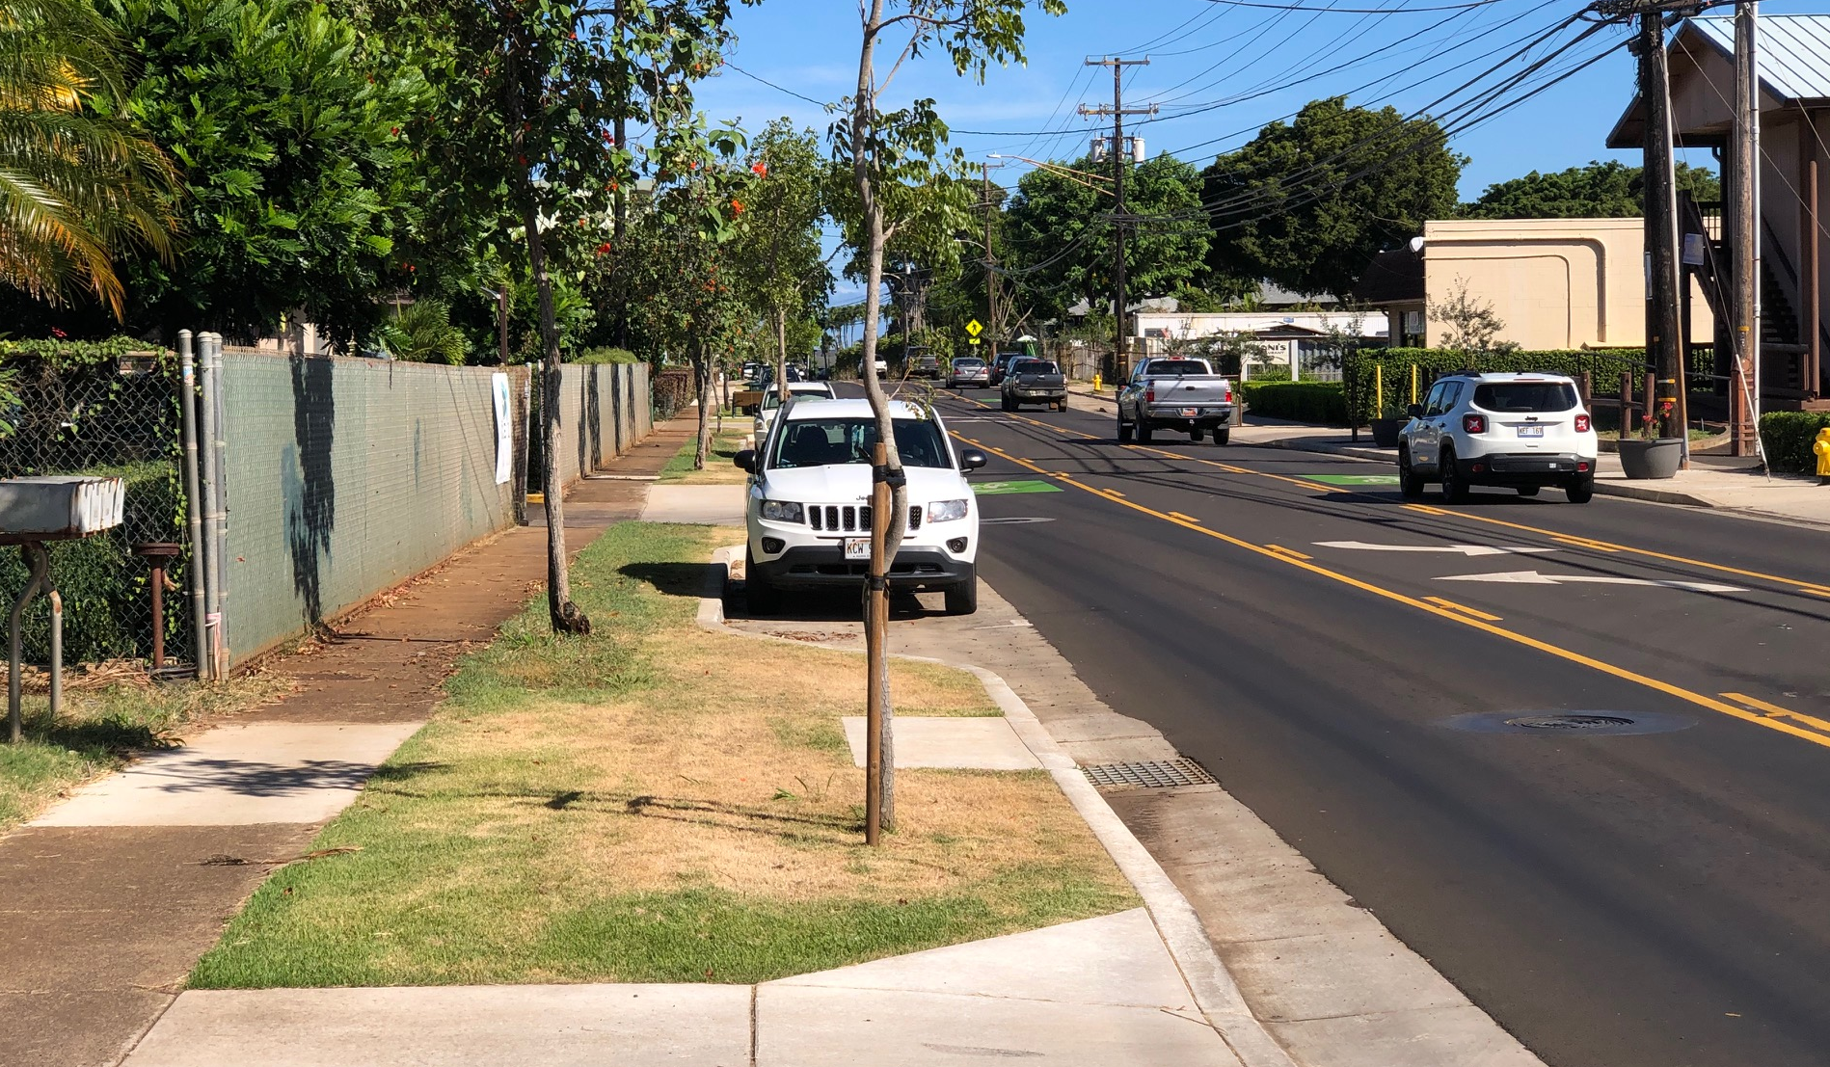
Līhu‘e Town Core Mobility and Revitalization
Complete Streets on Kaua’i

Slide 57
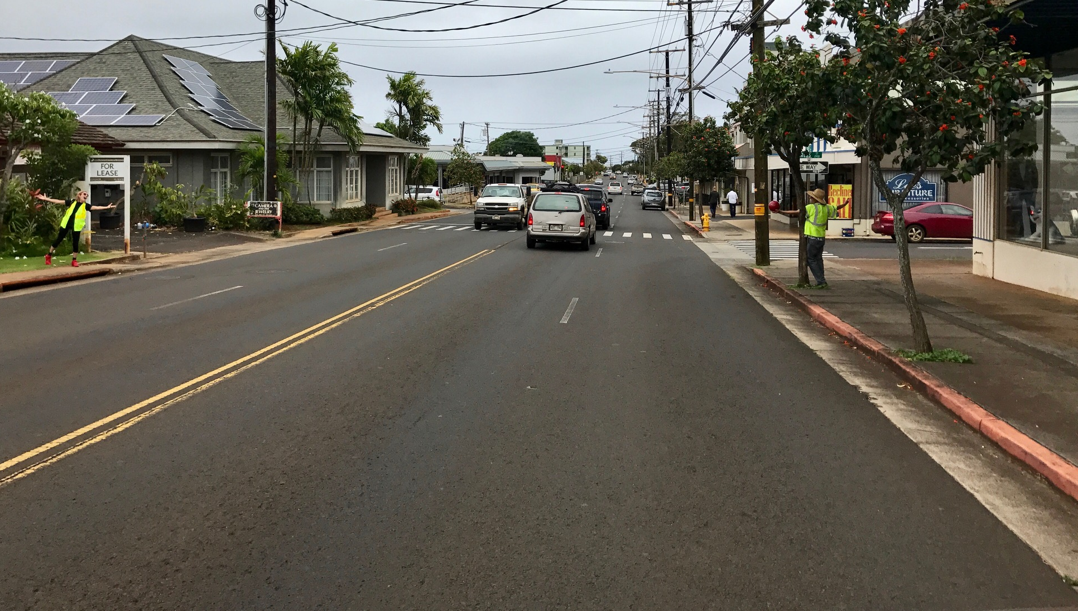
Līhu‘e Town Core Mobility and Revitalization
Complete Streets on Kaua’i

Slide 58
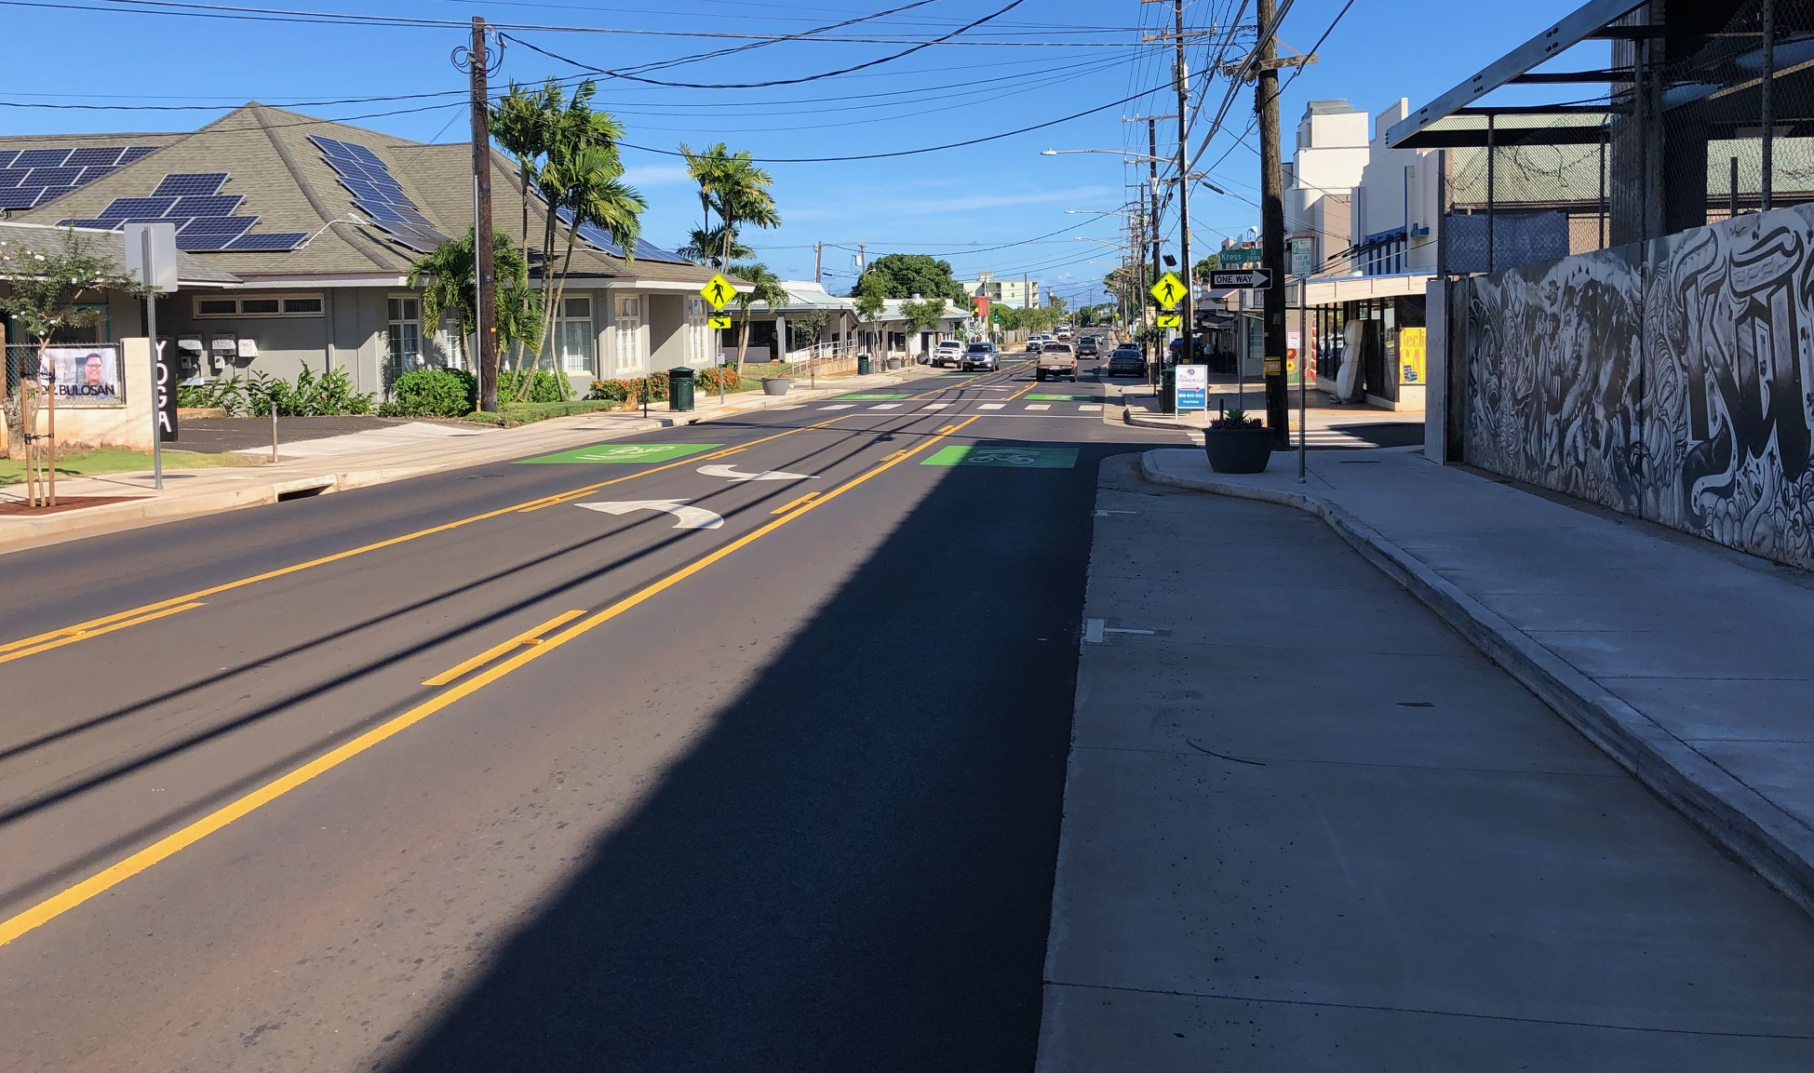
Līhu‘e Town Core Mobility and Revitalization
Complete Streets on Kaua’i

Slide 59
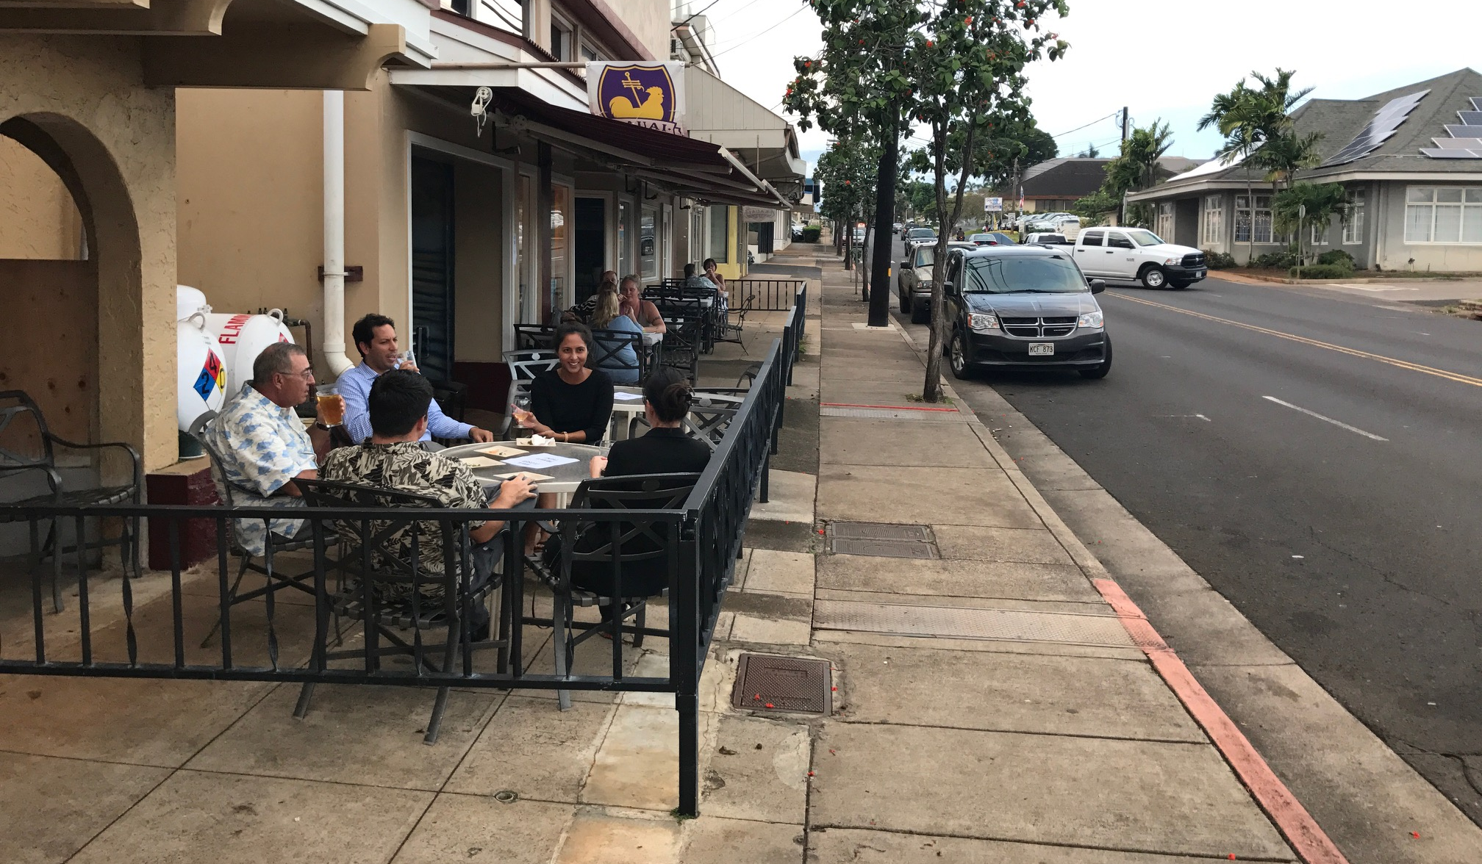
Līhu‘e Town Core Mobility and Revitalization
Complete Streets on Kaua’i

Slide 60
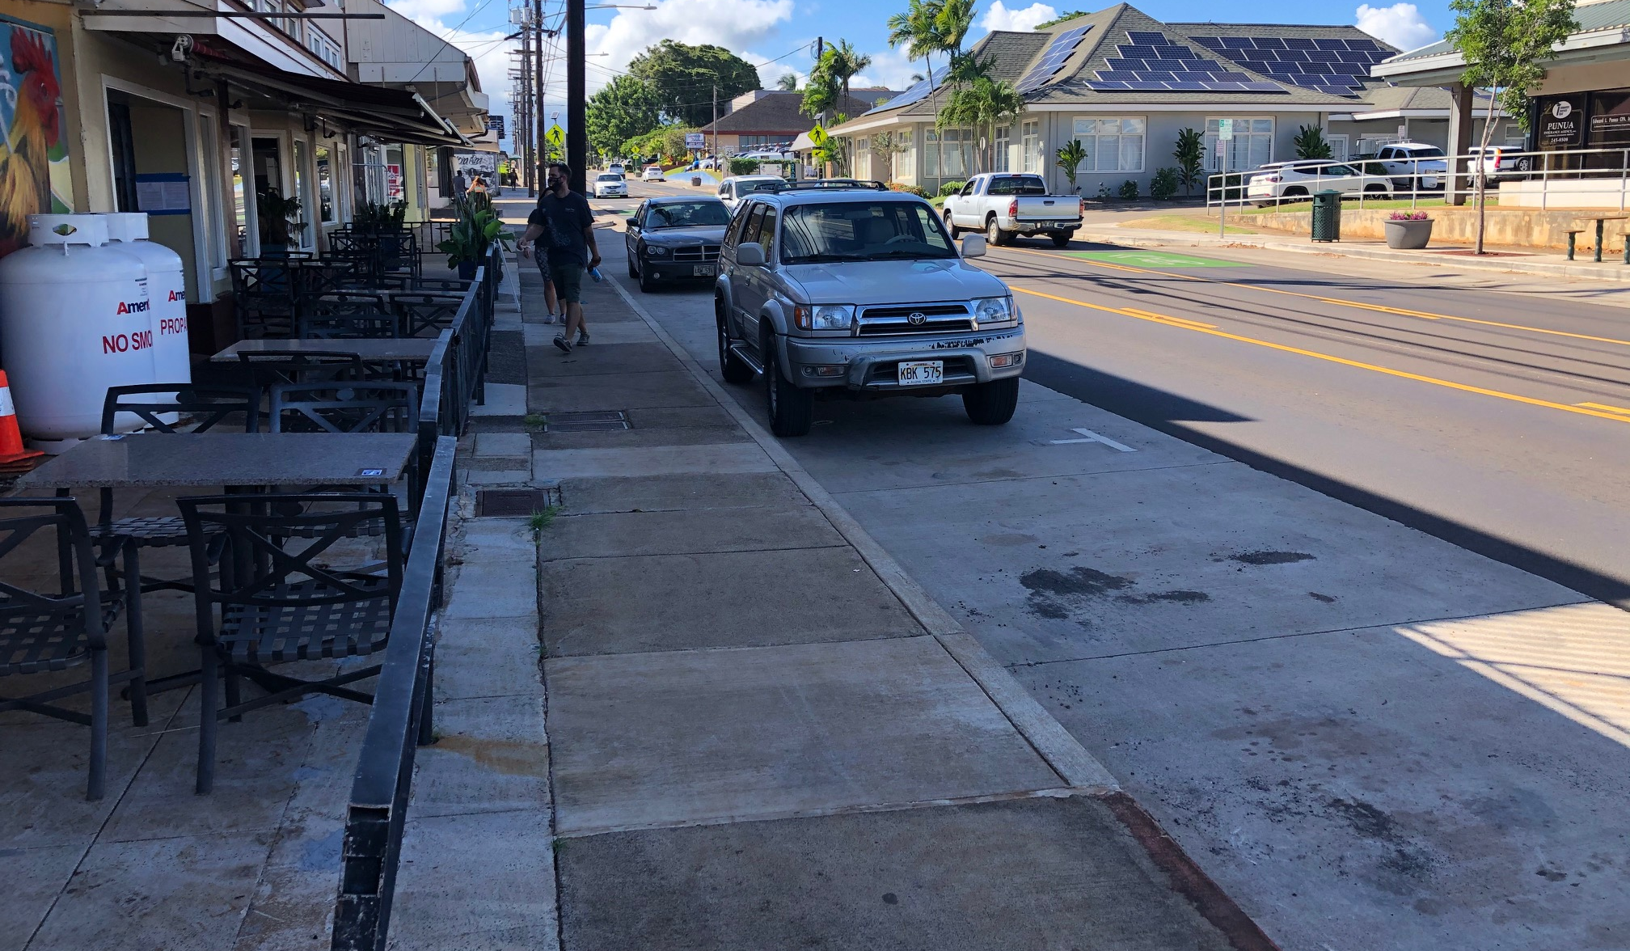
Līhu‘e Town Core Mobility and Revitalization
Complete Streets on Kaua’i

Slide 61
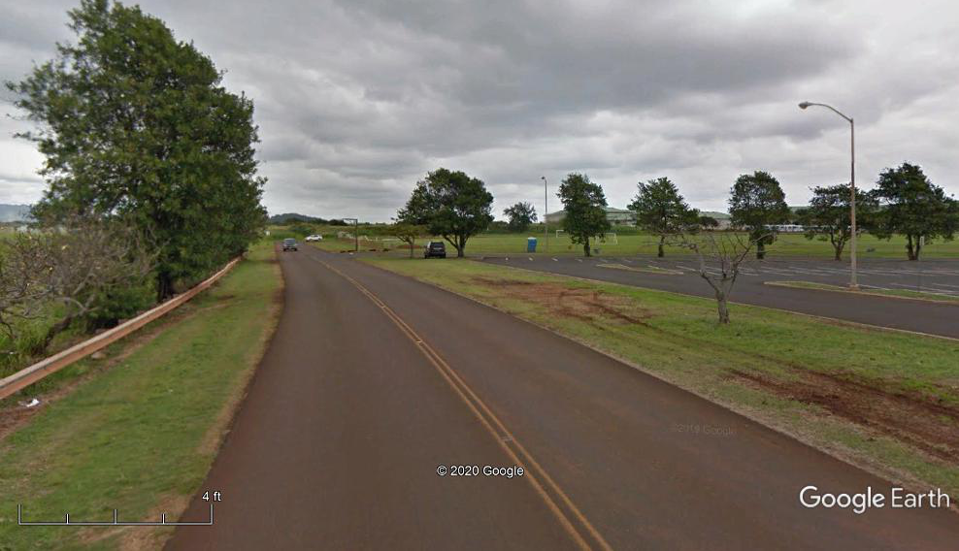
Līhu‘e Town Core Mobility and Revitalization
Complete Streets on Kaua’i

Slide 62
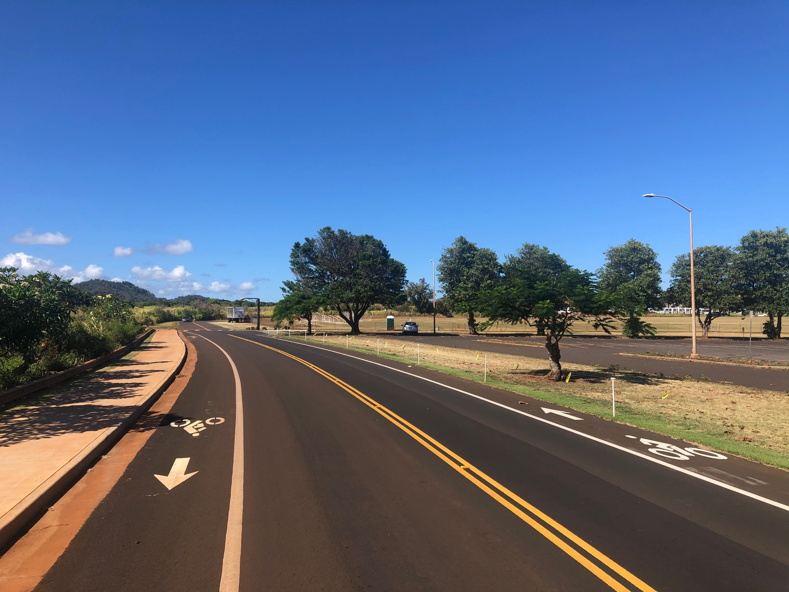
Līhu‘e Town Core Mobility and Revitalization
Complete Streets on Kaua’i

Slide 63
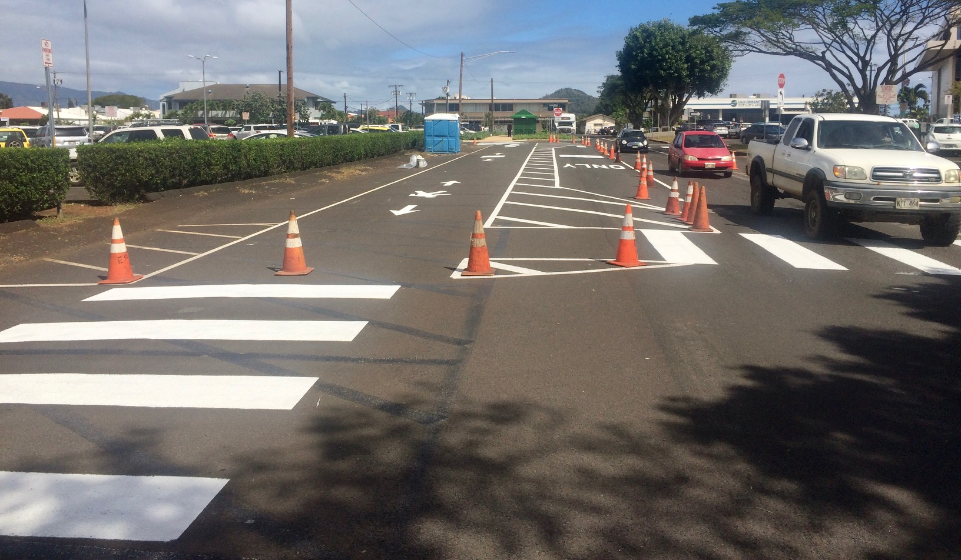
Līhu‘e Town Core Mobility and Revitalization
Complete Streets on Kaua’i

Slide 64
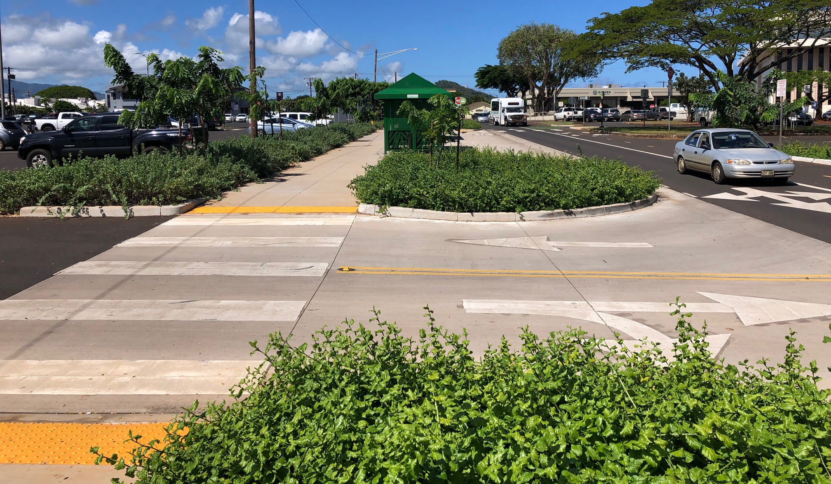
Līhu‘e Town Core Mobility and Revitalization
Complete Streets on Kaua’i

Slide 65
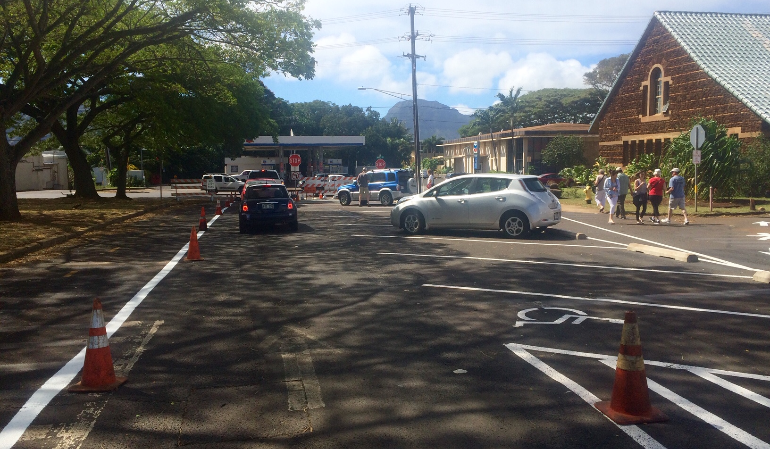
Līhu‘e Town Core Mobility and Revitalization
Complete Streets on Kaua’i

Slide 66
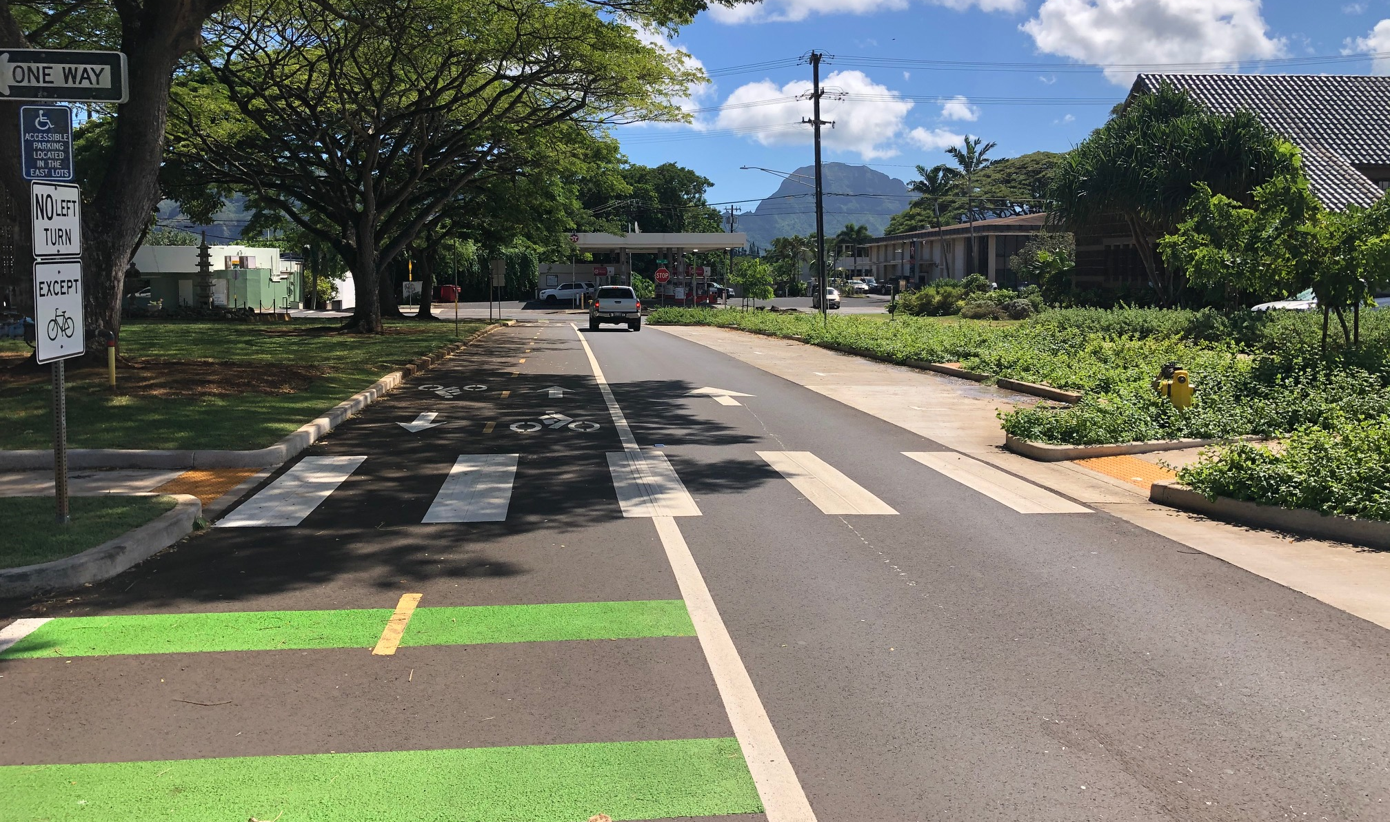
Līhu‘e Town Core Mobility and Revitalization
Complete Streets on Kaua’i

Slide 67

MAHALO!
Michael Moule, PE
Chief of Engineering
Kaua‘i County Public Works
mmoule@kauai.gov
Complete Streets on Kaua’i

